Slide 1
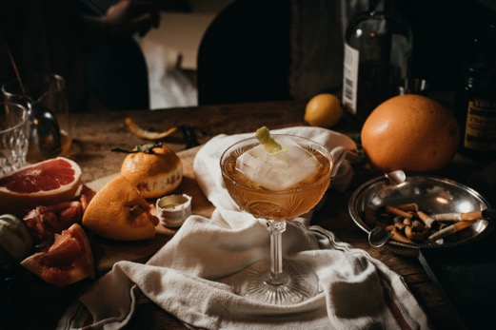
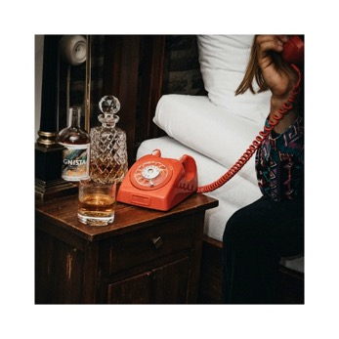
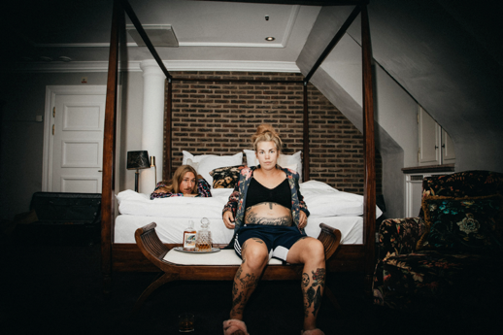
And the spirits of the future

Slide 2
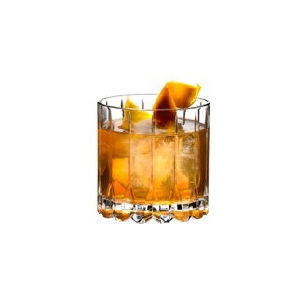
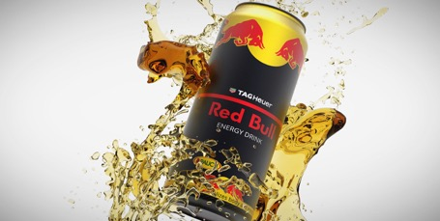
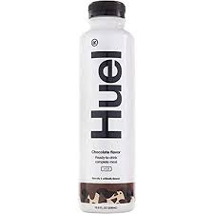
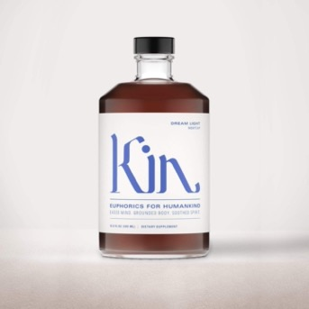
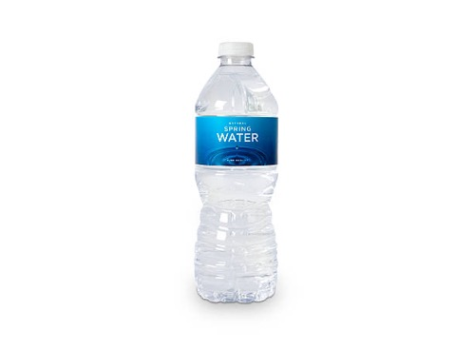
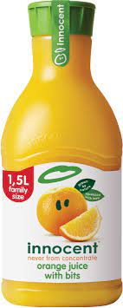
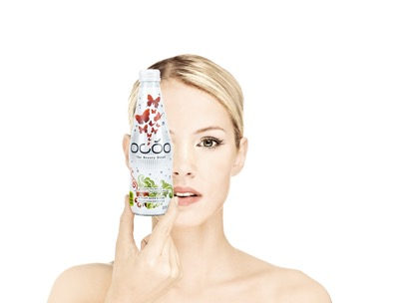
A DRINK, ANYONE?

Slide 3
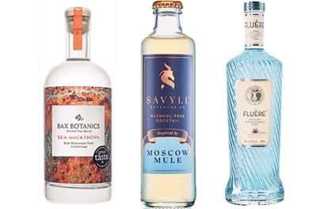
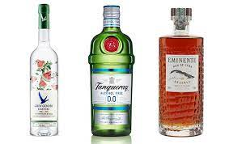
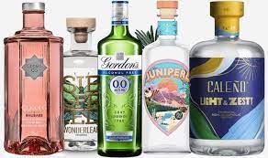
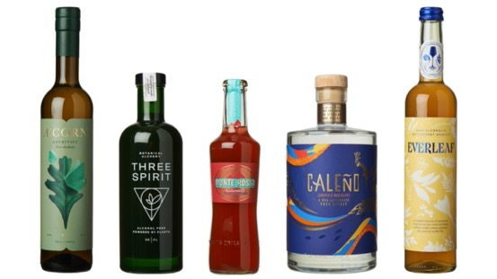
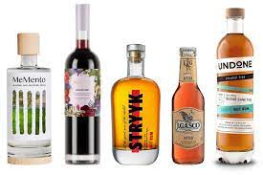
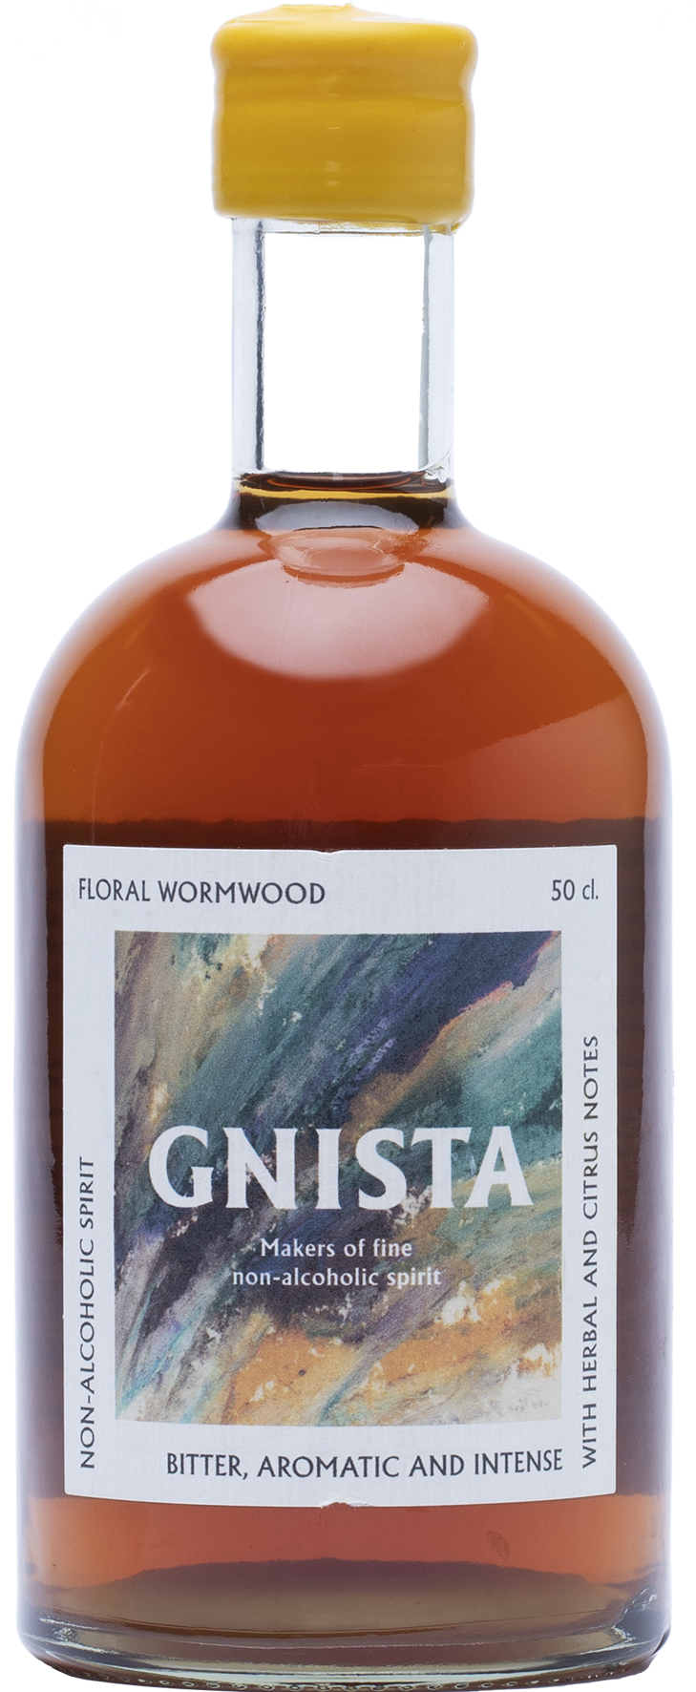
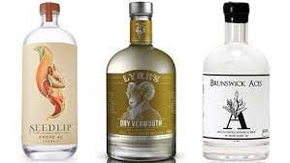
NON ALCO
SPIRITS ARE HAPPENING!

Slide 4
SO.. WHAT
IS A NA SPIRIT, REALLY?

Slide 5
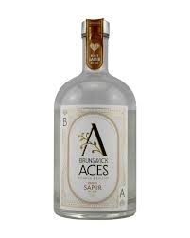
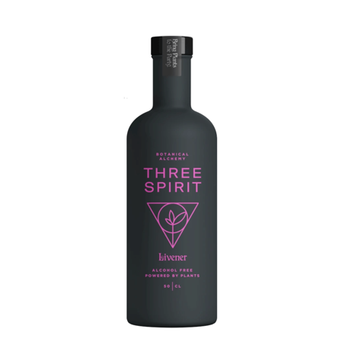
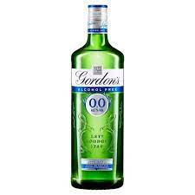
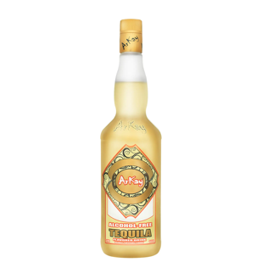
Distilled and botanical?
Functional?
Always best served with tonic?
With a burn replicating that of alcohol?

Slide 6
= CREATIVE BUT CONFUSING!

Slide 7
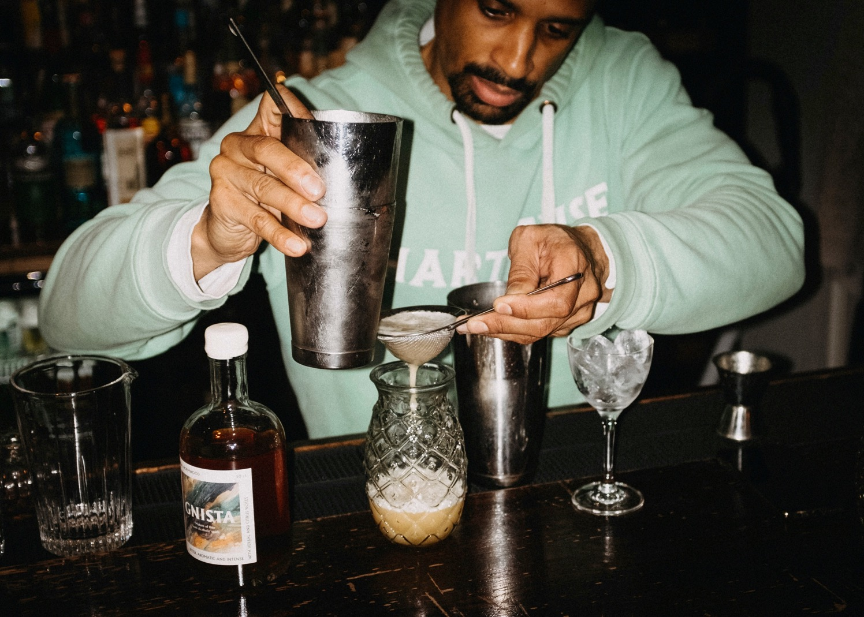
FOR US, IT’S ALL ABOUT THE OCCASION

Slide 8
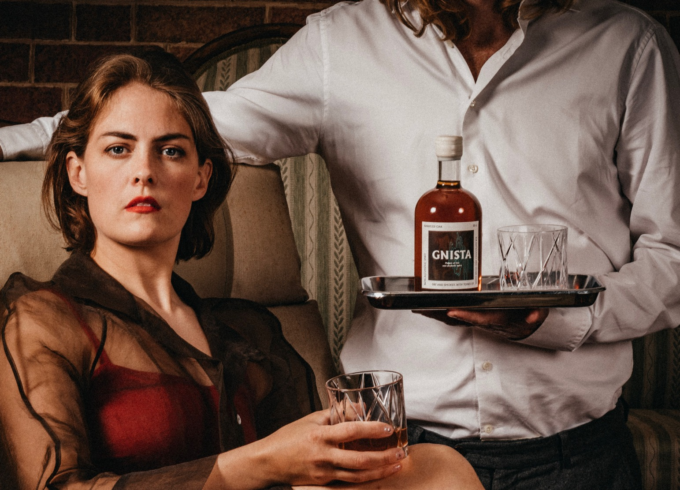
AND THE EXPERIENCE
“What is it that makes a whisky
so good?”

Slide 9
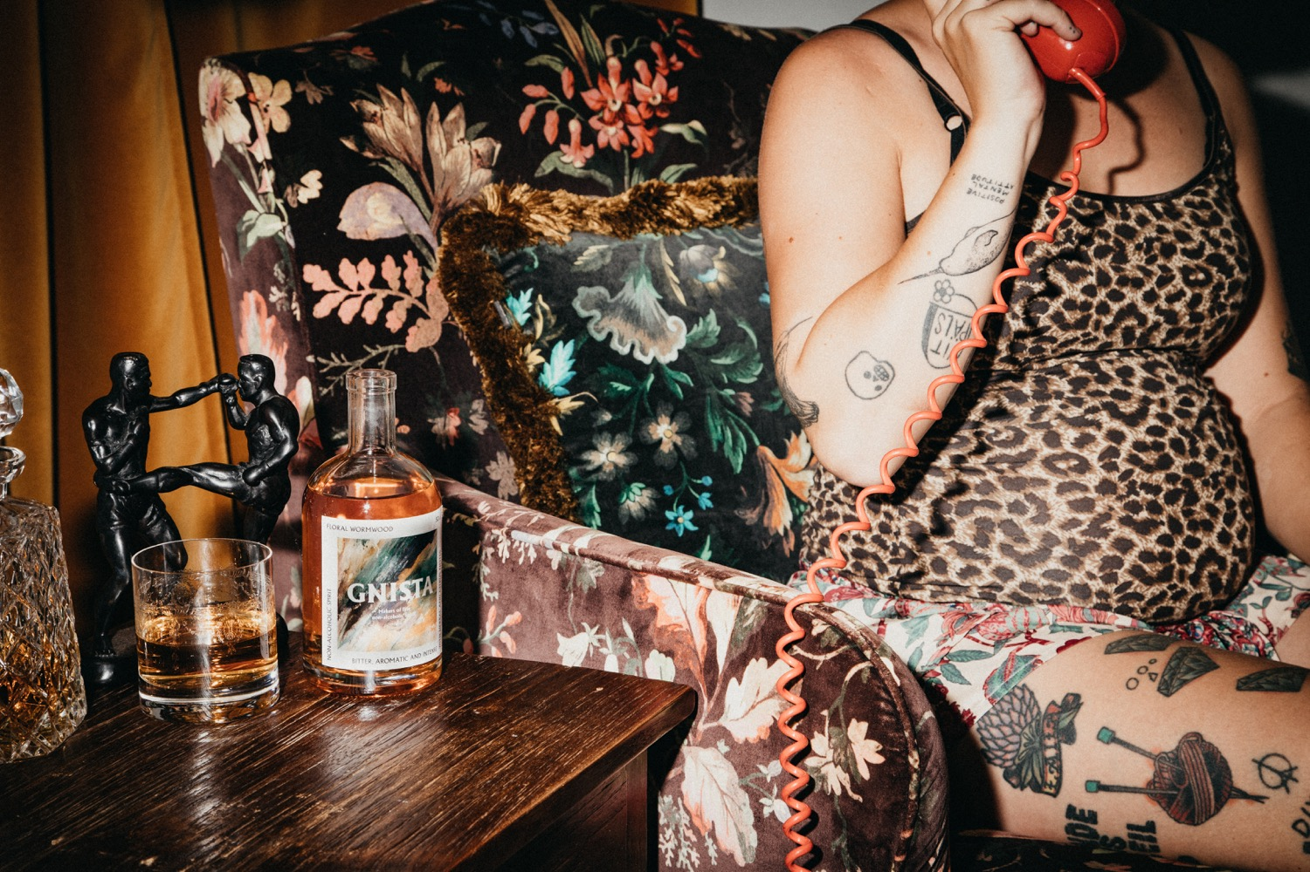
OUR PACKAGING
STRATEGY

Slide 10
When it comes to packaging,
we believe in
CONSUMER ABOVE BRAND
Notes:
reflecting the liquid

Slide 11
NON-ALCO SPIRITS, PACKAGING AND THE FUTURE
(Legal issues and who will
decide - consumer or industry?)
Notes:
Source: Gminsights.com and Mordorintelligence.com,
plus team calculations
Source: companieshouse.gov.uk and team calculations

Slide 12
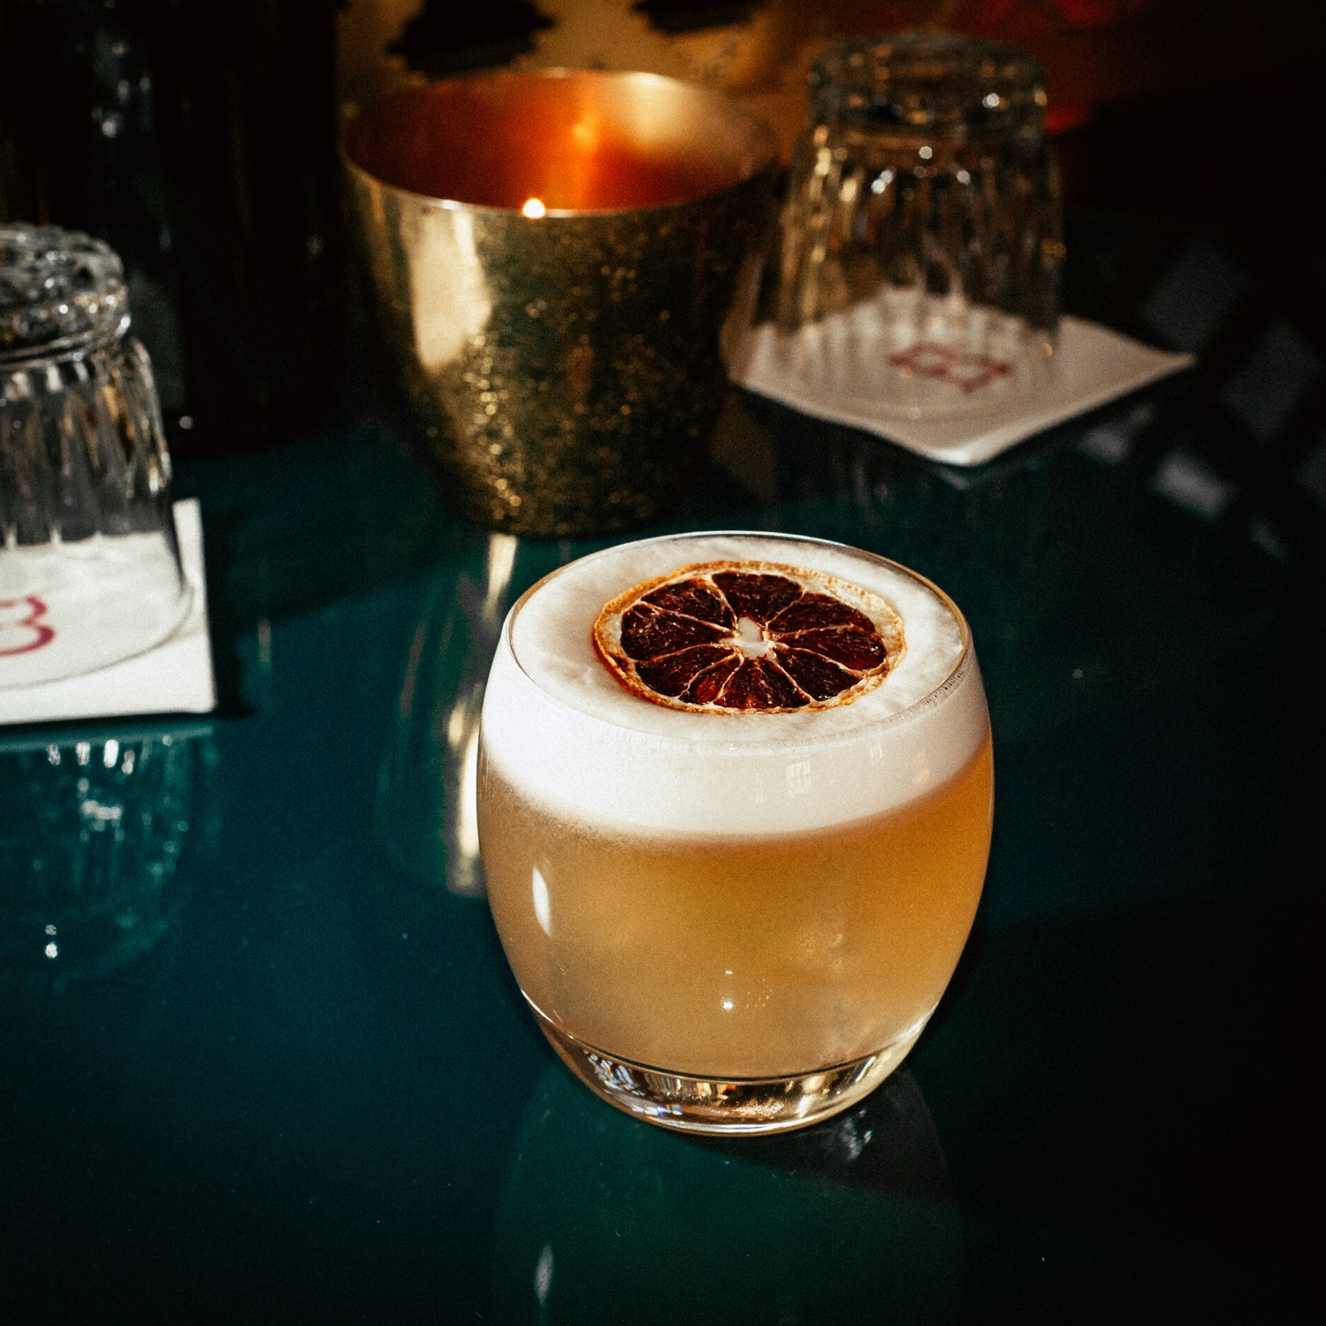
CHEERS! erika@gnistaspirits.com

