Slide 1
A path to new packaging steel
Global Packaged Summit
23-24 May 2022 Brussels – Armin von Keitz

Slide 2
Agenda today
Together we make the difference!
Sustainability is on everybody's lips and is our mutual responsibility, both corporately and on an individual basis. However, to achieve the transformation to a sustainable society we need a common understanding of sustainability.
Decarbonisation of steelmaking
Recycling rate and recycled content
Joint engagement with key decision makers that packaging steel is the most sustainable packaging material

Slide 3
The path to new packaging steels is about decarbonisation
Decarbonisation of steelmaking – medium and long term
Current position Tata Steel
Tata Steel decarbonisation plans, insight on 2030 and 2050 ambition
The route to 2030: expectations and value recognition of different deployment mechanisms on decarbonisation
Decarbonisation of Steelmaking - short term
Recycling rate and recycled content
Recycling rate – every loop is a decarbonisation step
Recycled content – replacing virgin material
Downgauging

Slide 4
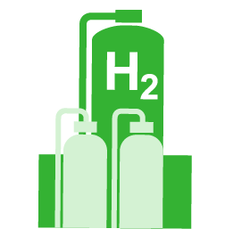
Greening steel production is more important than ever
Sustainable steel production is of great strategic and economic importance for the Netherlands and for Europe
Green steel: our commitment to sustainability is demonstrated by the choice of the hydrogen route
This is the route to fossil energy independence
Notes:
Wij zijn overtuigd van het grote belang van een duurzame staalindustrie in Europa.
Zoals de documenten van de EU Green Deal laten zien, wordt de staalindustrie van groot economisch en strategisch belang geacht voor Europa. Door de innovatieve en kwalitatief hoogwaardige producten die deze industrie levert. En door het belang van de sectoren, die deze staalproducten verwerken. Denk daarbij aan de automobielindustrie, de bouw, de producenten van batterijen en windmolens.
Belangrijke randvoorwaarde is dat de staalindustrie verduurzaamt. Tata Steel heeft zich gecommitteerd aan Parijs en aan het Nederlands Klimaatakkoord van 2018 . Wij zijn ervan overtuigd dat groen staal de toekomst is en stappen daarom versneld over naar waterstof. Op deze manier willen wij onze bijdrage leveren aan het voorkomen van verdere klimaatverandering en ook de impact op de directe leefomgeving zo beperkt mogelijk maken.
De recente ontwikkelingen in Oekraïne versterken de noodzaak om minder afhankelijk te worden van derde landen op het gebied van energie, staal en andere grondstoffen. Dit is van toenemend strategisch belang voor Nederland en de EU, zo blijkt ook uit het recente plan ‘RePowerEU’.
Tenslotte wil ik hier aan toevoegen dat onze keuze om over te stappen naar waterstof ook zal bijdragen aan de kickstart van de waterstofeconomie in Nederland. Samen met de Provincie, Port of Amsterdam en anderen onderzoeken we op welke wijze de energietransitie in de hele keten vorm krijgt in het Noordzeekanaalgebied.

Slide 5
Tata Steel is committing to a clean, green future with two programmes in the Netherlands
Roadmap Plus
Transition to clean, green steel
Reduction of local emissions and improvement of local nuisance situation by taking environmental measures, incl. dedusting and deNOxing the pellet plant, and limiting emission at the cokes plant
Transition to green hydrogen-based steel making by replacing current blast furnace-technology with DRI-plants and electric furnaces
Implementation timeline of 2019-2025
Implementation timeline of 2022-2035
35%
PM10 (fine dust) reduction by 2023¹
30 - 40%
CO₂ emissions reduction after first BF-replacement by ’30²
85%
Odour reduction by 2023¹
60 - 70%
CO₂ emissions reduction after second BF-replacement by ’35²
50%
PAH-emissions reduction by 2022¹
100%
CO₂ emissions reduction by ’50¹
30%
NOx emissions reduction by 2025¹
Reduction compared to 2019 emissions
Reduction compared to 2019 emissions
Reduction compared to 2019 emissions and based on phasing out of BF6
Notes:
We are working on 2 programs to enable green steel in a clean environment.
Firstly, Roadmap Plus, which is aimed at the accelerated implementation of environmental measures against dust, odor and PAH substances. Whereby by 2025 at the latest……​
At the same time, we are working on the transition to green steel:​
This means that by 2050 we will be producing CO2 neutral steel based on hydrogen.
That we will have already phased out our first blast furnace by 2030 and that we are making steel instead with new technology and based on hydrogen.
That by replacing the first blast furnace in 2030 we will have reduced at least 30% of our CO2 emissions. We are still investigating which additional measures we can take to achieve a 40% CO2 reduction.
We then phase out the second blast furnace in order to be able to reduce the remaining 60 - 70% CO2.​
We want to be sure that we can produce the same amount of steel of the same quality on that scale.

Slide 6
Tata Steel in the Netherlands is currently is one the most CO₂ efficient producers globally…
CO₂ intensity per steel production site globally
Tonne CO₂ per tonne produced steel, 2020
5.0
Tata Steel IJmuiden is ranked no.2 of 65 operations globally on lowest tonne CO₂ emission per tonne steel
4.5
4.0
3.5
3.0
2.5
2.0
1.5
1.0
1
6
0.5
0
Source: World Steel CO2 data report 2020, BF-BOF route. Calculations incl. scope 1, 2, 3 emissions as per World Resources Institution, World Business Council for Sustainable Development and greenhouse gas protocol
Notes:
Tata Steel Netherlands is one of the most CO2-efficient steel companies worldwide.
TSIJ is in second place in WorldSteel's most recent benchmark when it comes to making CO2 efficient steel. Which companies are in the other places is not made public.
This is the result of years of effort to make our steelmaking process as energy-efficient as possible.​
In recent years we have already done a lot to achieve this, but to be able to meet the climate ambitions, this is not enough.

Slide 7
Focus of our transition to green steel
Coal
Coal
Notes:
90% of the emissions occur during the production of (raw) iron. See steps 1 and 2. This is largely due to the use of coal. In order to achieve our climate ambitions, we therefore have to start greening there.
IJmuiden is now an integrated steel company where we produce steel from coal.
The raw materials iron ore and coal are first processed into pellets/sinter and coke (step 1).
In the blast furnace, the sinter and pellets are heated and converted into iron with the carbon from the coke (step 2).
In the steel factory, steel is made from the liquid pig iron (step 3).
In our decarbonisation strategy, we reach into the so-called heart of our production process. And we are replacing the blast furnaces, which run on coal, with a new technology that can make steel based on hydrogen. In addition, we are also investigating which additional CO2 measures are needed to reduce our CO2 emissions before 2030. This goes further than TSIJ, we also look at the entire value chain (including DSO). Examples that you can think of are the further reduction of CO2 emissions during the transport of raw materials to the factory and of our products to the customer.

Slide 8
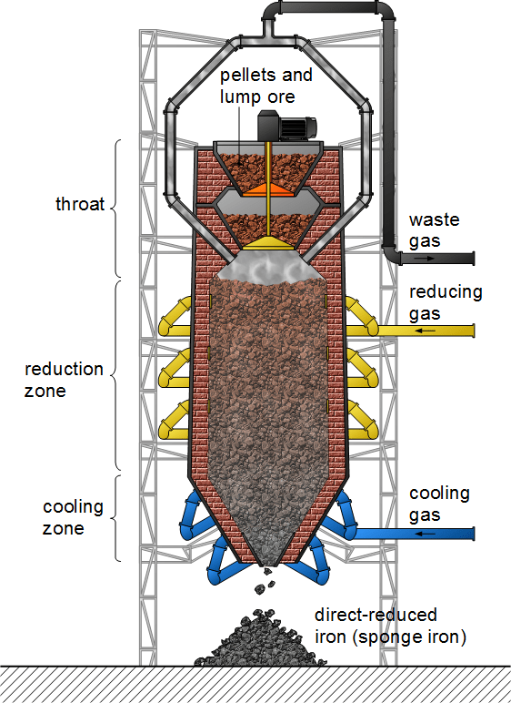
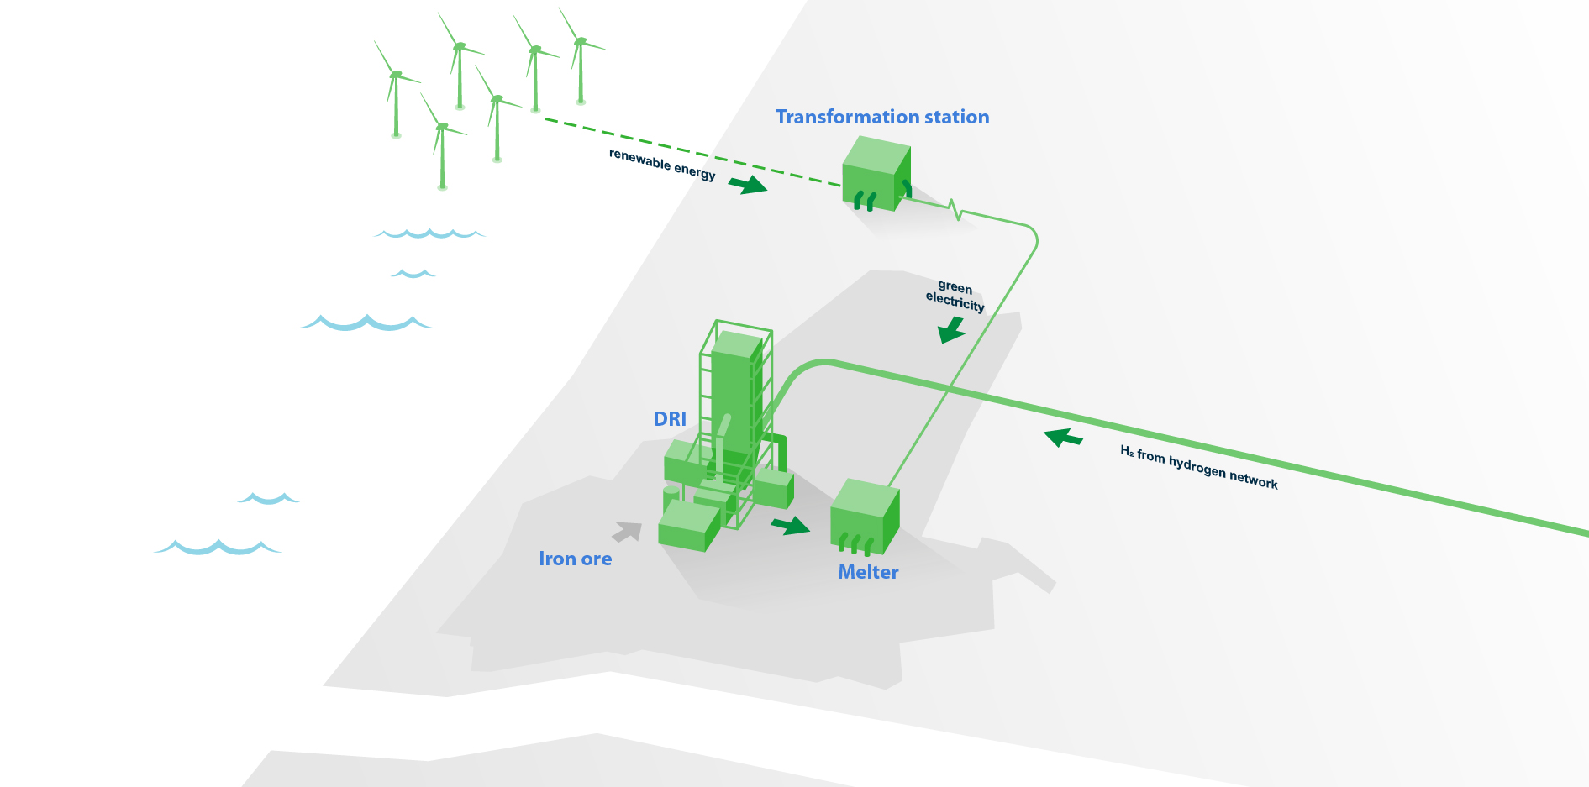
DRI technology based on green hydrogen
H₂O
H₂
Notes:
With the switch to DRI technology, TSN can switch to hydrogen-based production.. ​
To start making green steel, we are replacing our blast furnaces with Direct Reduced technology. This is a technology that, in combination with electric furnaces, can make iron from hydrogen and/or natural gas.
How it works: ​
In a DRI plant you make reduced iron pellets that have not yet been melted.
Instead of coal and coke, this technology uses hydrogen or natural gas to reduce the pellets.
You then take these pellets to an electric furnace (bottom left) where they are melted with electricity into liquid pig iron.
We use green electricity for this that comes from wind farms at sea.
Steel is made from this liquid pig iron in the steel factory.
The choice to make steel based on hydrogen is the biggest change in our steelmaking process since the founding of the Hoogovens (in 1918).

Slide 9
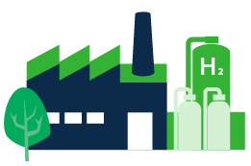
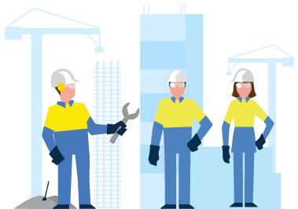
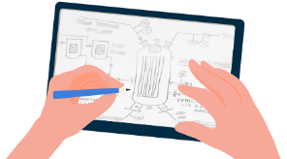
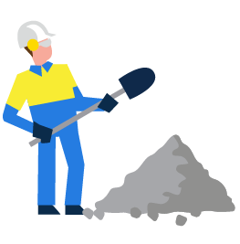
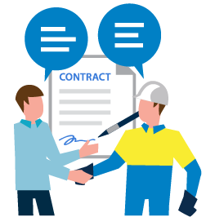
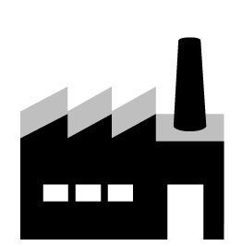
Our path to green steel in a clean environment has five phases
Start-up phase
Construction phase
Construction preparation phase
Closure of old factories
Design
Engineering phase
2021
2022
2023
2024
2025
2026
2027
2028
2029
Today
9
Notes:
Design, construction & delivery​
The concept design is currently being made.
Based on this, we can make design decisions such as whether to replace the blast furnaces with 1, 2 or 3 DRI plants and when and how many electric furnaces will be needed. We expect to be able to do this at the beginning of Q2 2022.​
After that, the real design of the new installations begins.
Mid 2022 we want to submit the first formal documents to start the various permit processes as early as possible.
Permits and participation​
The participation process will start in the first quarter of 2022, whereby we will include local administrators and the environment as early as possible in our plans. With the aim of giving them as much say as possible where possible.​
In mid-2022, we want to submit the first formal documents in which the project is broadly described​
We aim to have submitted the permit applications by the end of 2023.
Delivery of DRI plant
We expect the completion of the DRI factory and electric ovens at the end of 2028. After this we start production and we will increase production further and further. At the same time, we are phasing out production in the blast furnace. We want to switch these off completely by 2030 at the latest and start dismantling them.
H2 and green energy​
Discussions are currently underway with various hydrogen providers about possible collaboration.​
We have also concluded an agreement with Tennet for connection to the high-voltage electricity network

Slide 10
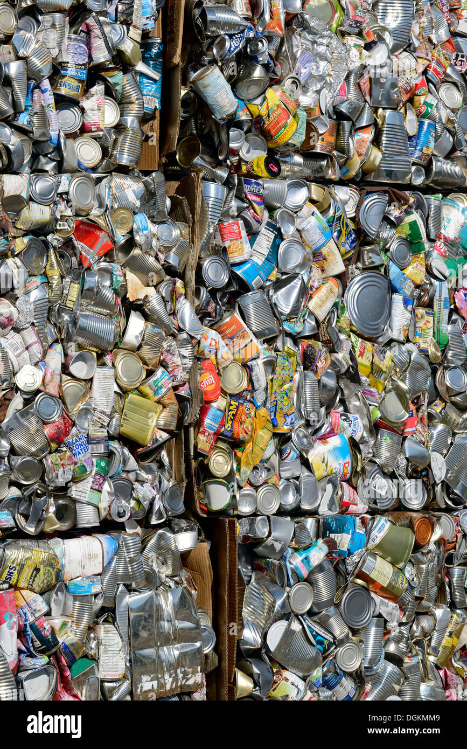
Short term decarbonisation
Recycling rate and recycled content
Recycling rate: all steel placed on the market is an investment into the future and each recycling loop of this can brings a return and is a step towards decarbonisation.
Recycled content: every tonne of secondary packaging scrap used in production of new Steel for Packaging replaces the same volume of virgin steel and reduces carbon emissions significantly.

Slide 11
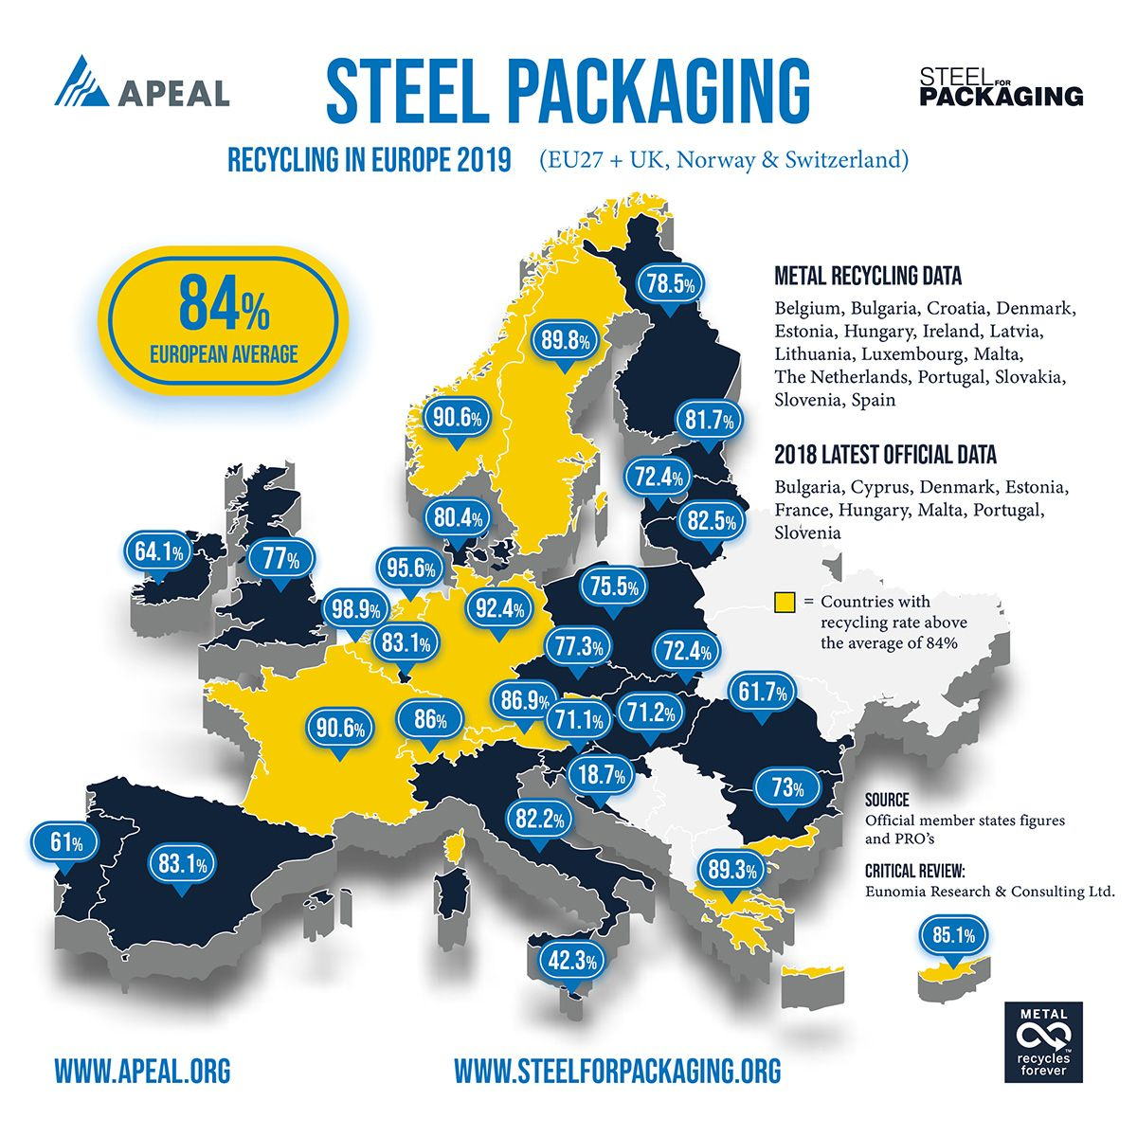
Steel is the most recycled material in the world
84% of steel packaging is recycled in Europe
Because steel has magnetic properties, it can be easily recovered from all efficient waste streams.

Slide 12
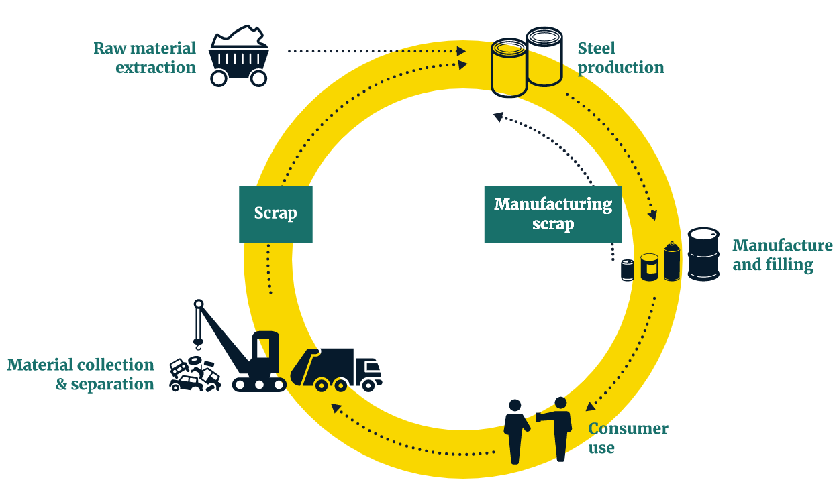
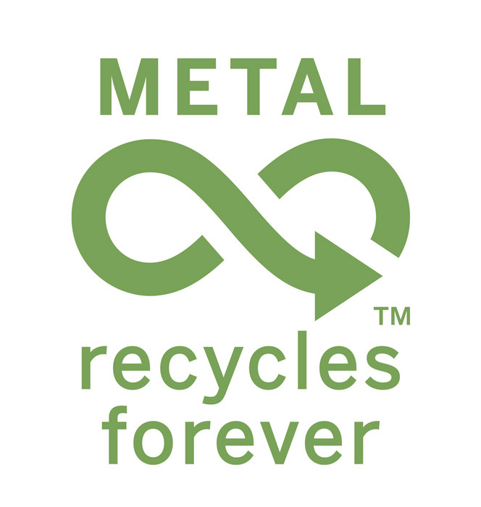
Packaging steel is a closed loop in recycling
Steel is the only material with a closed recycling loop. Steel is not consumed. Steel is a permanent material that can be infinitely recycled without any loss of quality
Notes:
Recyclability

Slide 13
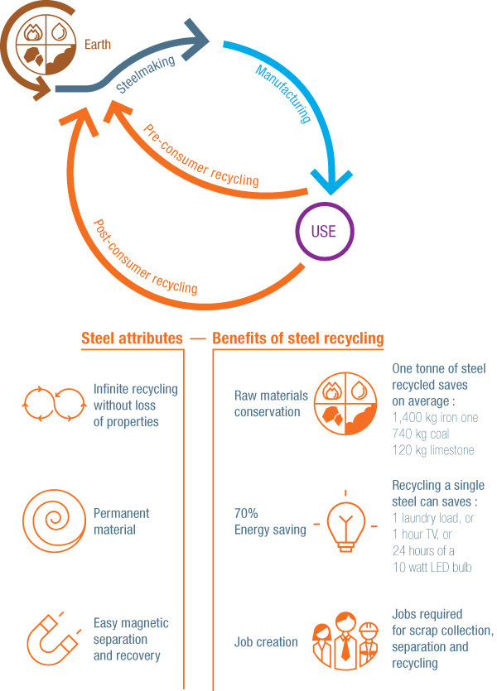
Steel recycling savings
Returning steel cans enables average savings of 1.67 tonnes of CO₂/tonne material and material savings:
Over 1,400 kg of iron ore, 740 kg of coal, and 120 kg of limestone are saved for every 1,000 kg of steel scrap made into new steel.
Data source: worldsteel

Slide 14
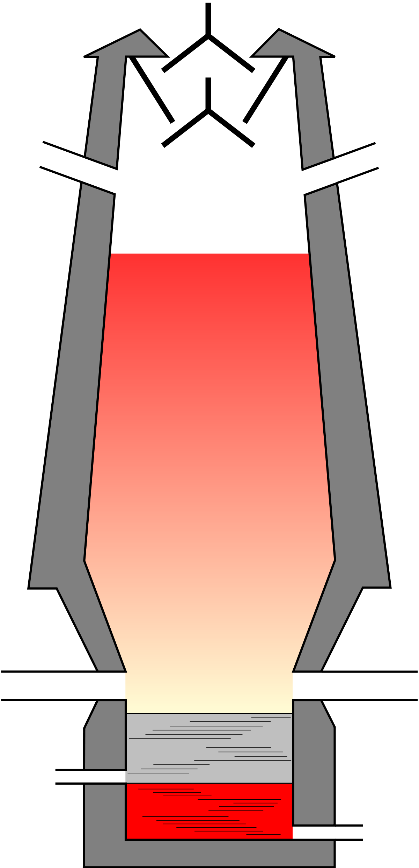
Short term decarbonisation - recycled content
Blast Furnace Route
Recycled Content % = $\frac{iron content scrap (t)}{steel product(t)}$
- 0.016t CO₂ per % recycled content
Liquid Iron
Converter
Scrap
Product
Short term goal: increase scrap volume - decrease liquid steel to save up to 10% carbon emissions
Notes:
Total no pack recycled/total no pack produced

Slide 15
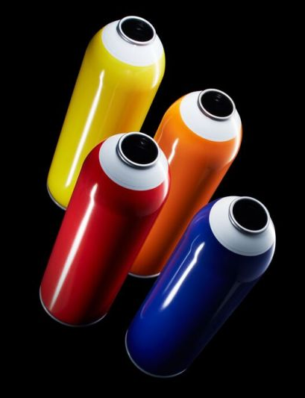
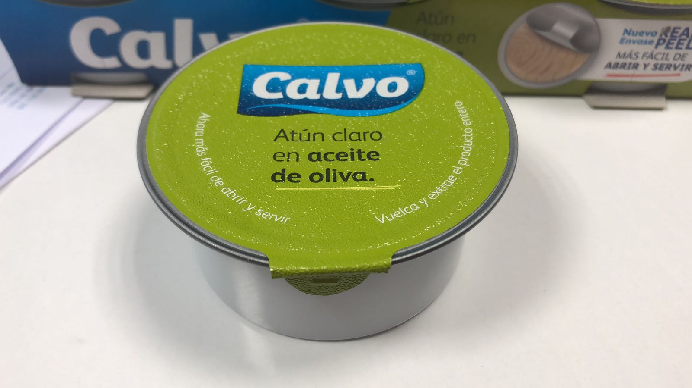
Working together: Sustainability by innovation
Innovation can create sustainability
Material downgauging: new generation steel cans weigh as little as 41g which is 46% lighter than 30 years ago, 46% lighter means 46% less carbon emissions
Green packaging steel will be available soon
Innovative design with a green emphasis is a concept for the future of steel for packaging

Slide 16
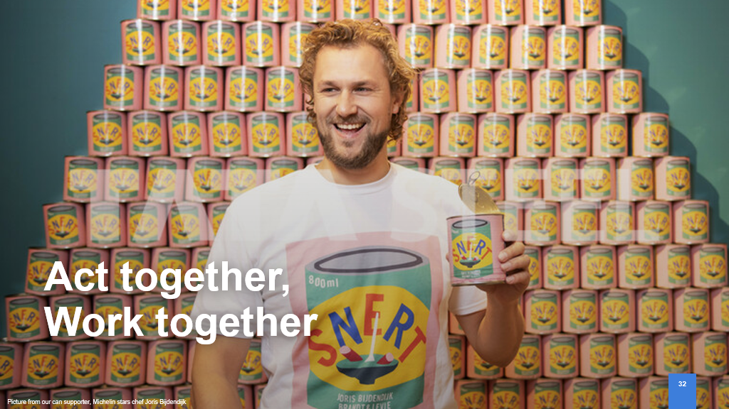
Act together, Work together
Picture from our can supporter, Michelin stars chef Joris Bijdendijk

Slide 17
Do you have any questions?
Tata Steel
Packaging
www.tatasteeleurope.com/packaging

