Slide 1
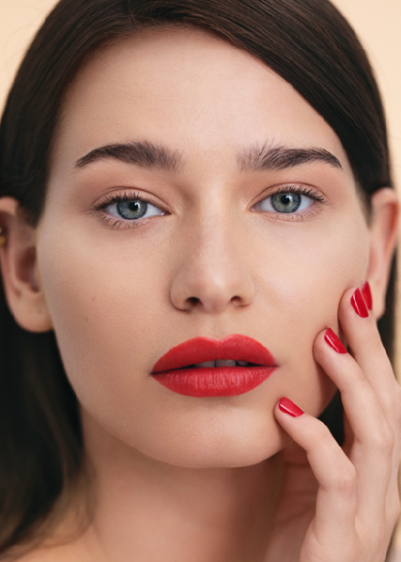
OUR PACKAGING TRANSFORMATION JOURNEY
Caroline Thunstedt CEO
Anna Agardh Sustainability Manager
Global Packed Summit
2022-05-24

Slide 2
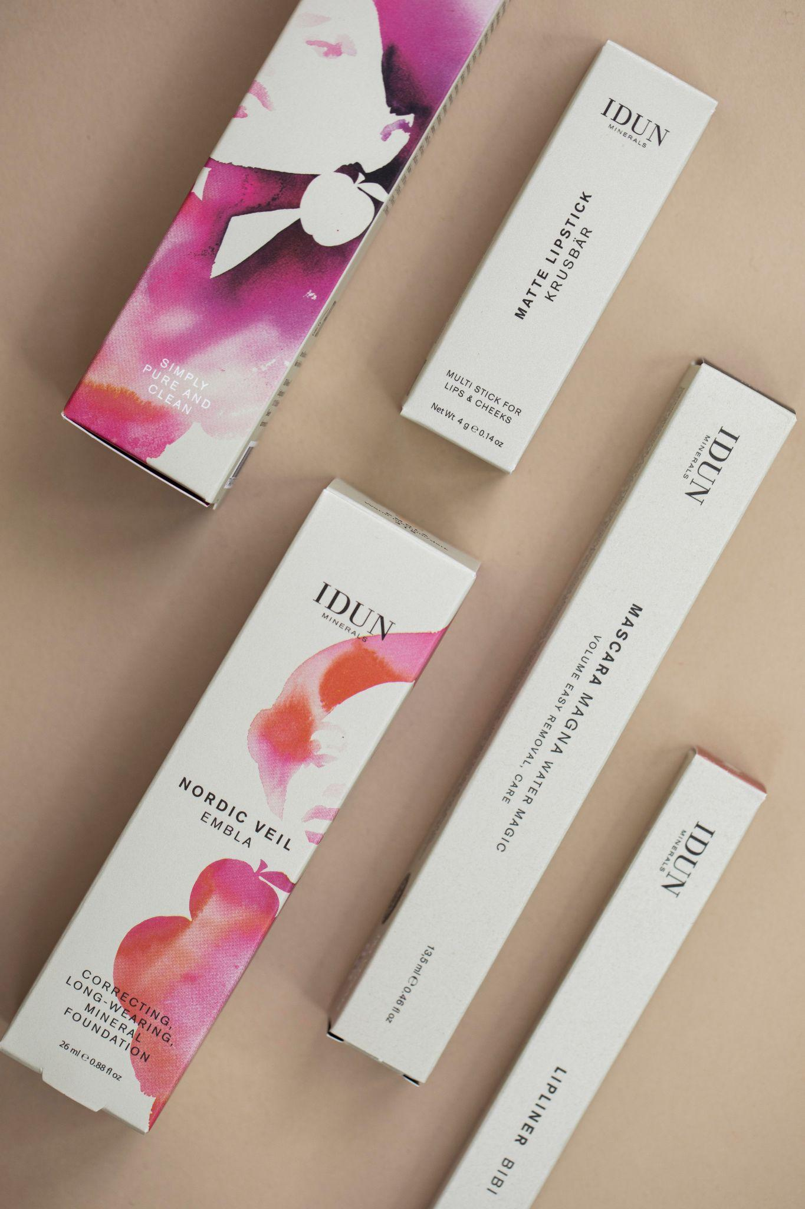
AGENDA
Background
Our Sustainability Focus
Packaging Transformation Journey
Communication
Our Wishlist - For A Better Future

Slide 3
Z
BORN IN STOCKHOLM, GLOBALLY LOVED.
Born in Stockholm more than 11 years ago, on International Women’s Day, IDUN Minerals is a beauty brand that combines high-performance formulas and high-quality results, thanks to ingredients that protect and care for the skin. The products are formulated in close cooperation with researchers and dermatologists and are developed for all skin types, even the most sensitive.
Striving for inclusiveness, the assortment consists of a wide shade range infused with highly purified minerals. With the ambition to be a sustainable beauty brand, IDUN Minerals has an increased focus on local production, transparency, becoming 100 % vegan, and reducing the environmental impact of its products.
Notes:
Born in Stockholm more than 11 years ago, on International Women’s Day, IDUN Minerals is a beauty brand that combines high-performance formulas and high-quality results, thanks to ingredients that protect and care for the skin. The products are formulated in close cooperation with researchers and dermatologists and are developed for all skin types, even the most sensitive.
Striving for inclusiveness, the assortment consists of a wide shade range infused with highly purified minerals. With the ambition to be a sustainable beauty brand, IDUN Minerals has an increased focus on local production, transparency, becoming 100 % vegan, and reducing the environmental impact of its products.

Slide 4
Z
THE STORY OF IDUN
Idun, in Norse mythology, was the goddess of beauty, eternal youth and rejuvenation. She was known to be the keeper of magic golden apples, known to provide the Gods with the ability to sustain immortality, making them eternally young and beautiful. IDUN Minerals highlights the goddess Idun in the brand name as part of its Nordic heritage but also as a symbol of beauty and female strength.
Notes:
Idun, in Norse mythology, was the goddess of beauty, eternal youth and rejuvenation. She was known to be the keeper of magic golden apples, known to provide the Gods with the ability to sustain immortality, making them eternally young and beautiful. IDUN Minerals highlights the goddess Idun in the brand name as part of its Nordic heritage but also as a symbol of beauty and female strength.

Slide 5
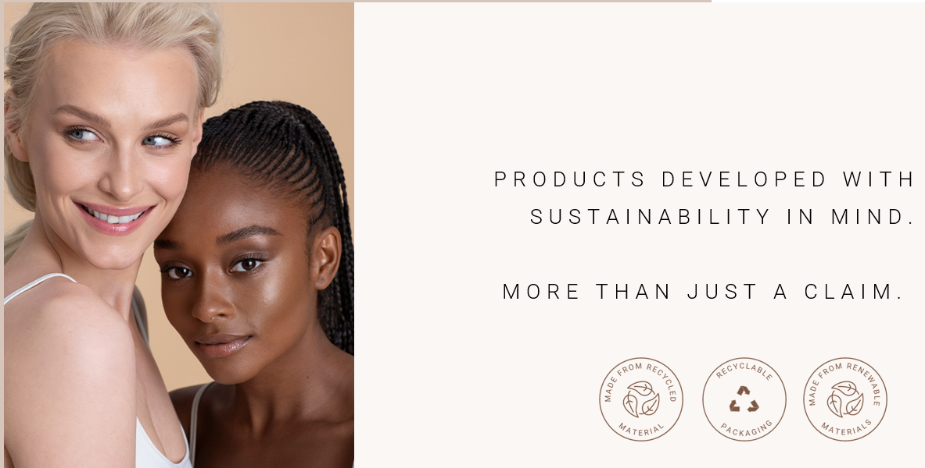
INSERT HEADLINE
INSERT COPY
INSERT COPY
INSERT COPY
INSERT COPY
INSERT COPY
INSERT COPY
INSERT COPY
INSERT COPY

Slide 7
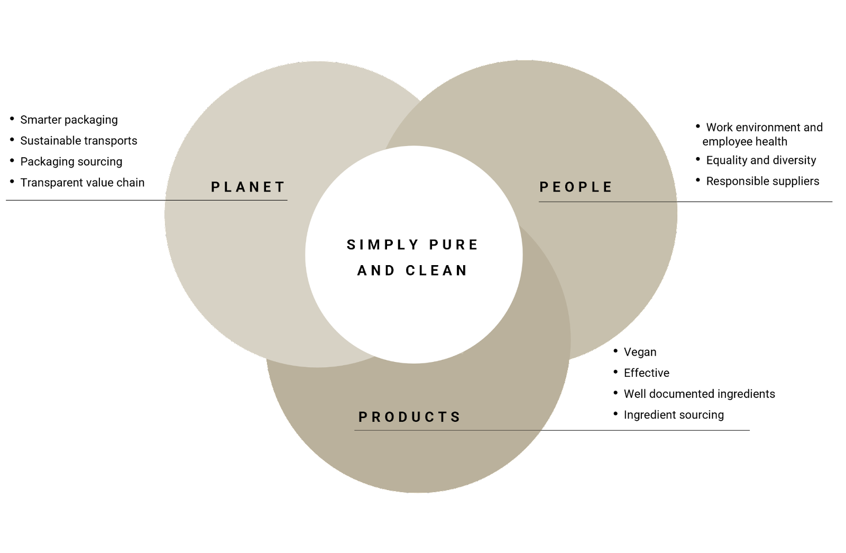
SUSTAINABILITY FOCUS AREAS

Slide 8
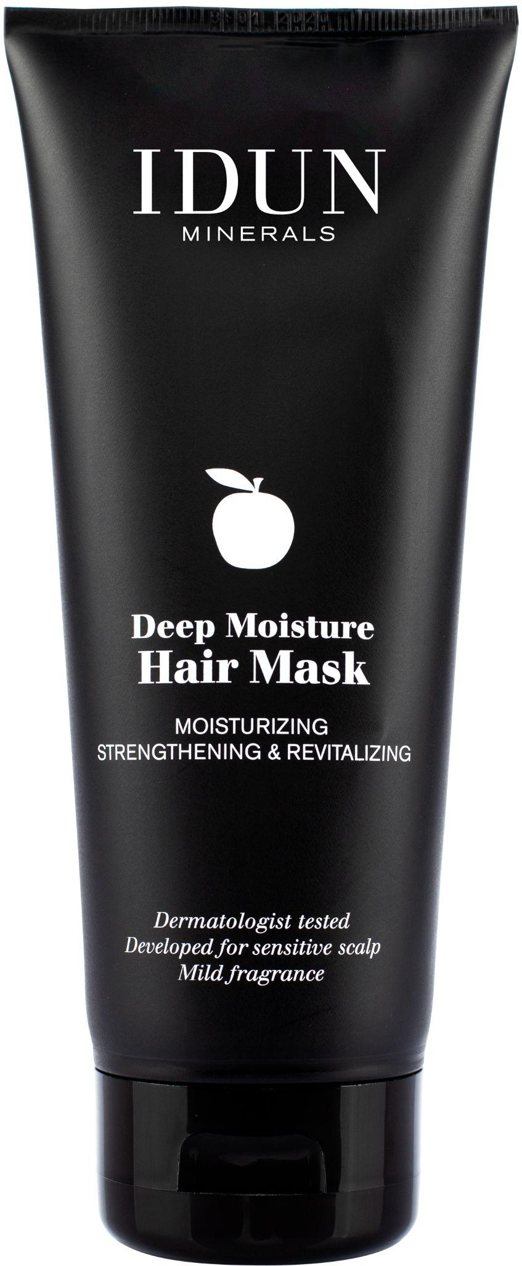
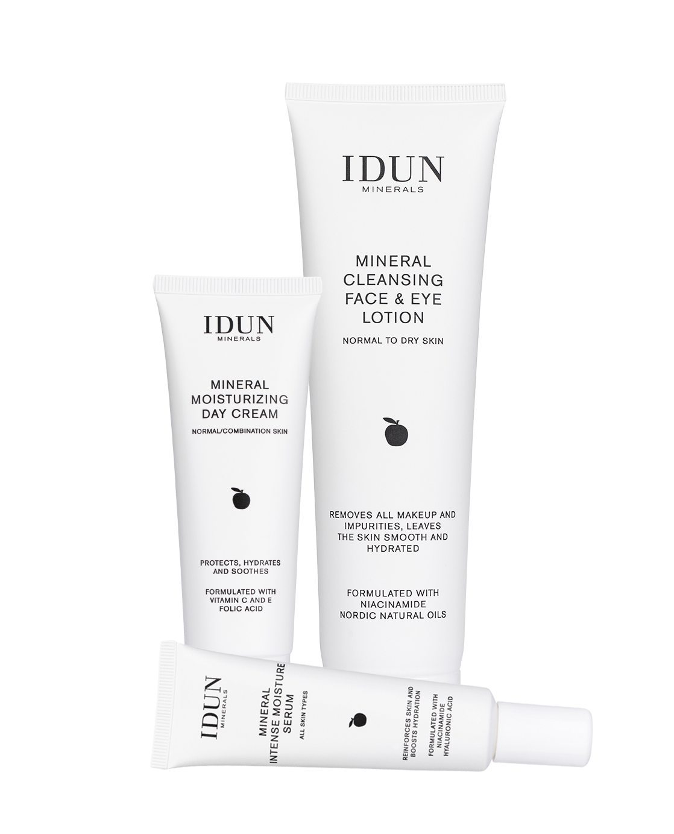
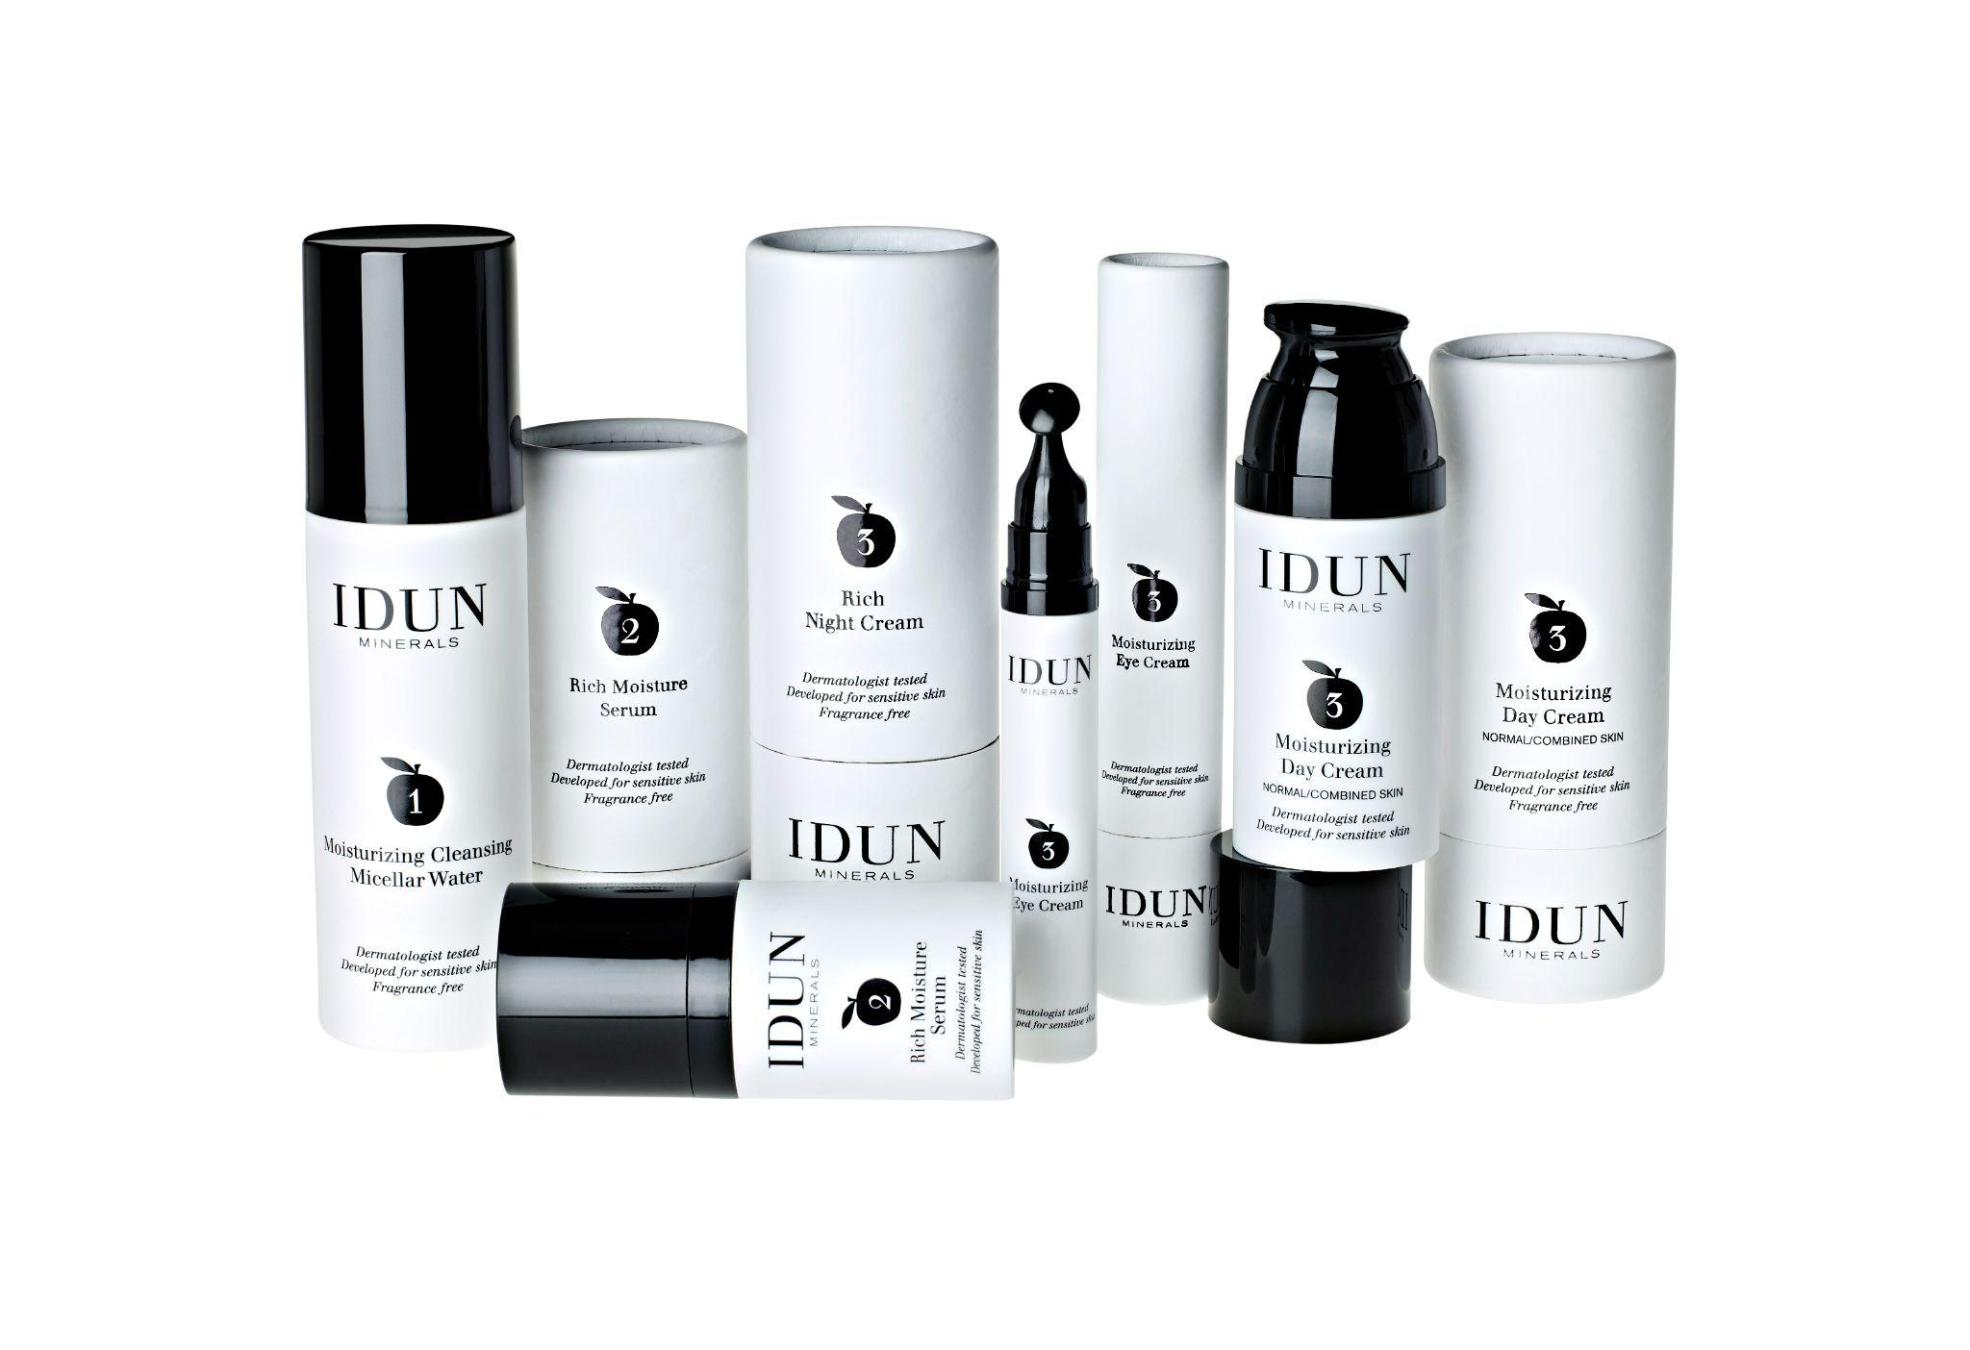
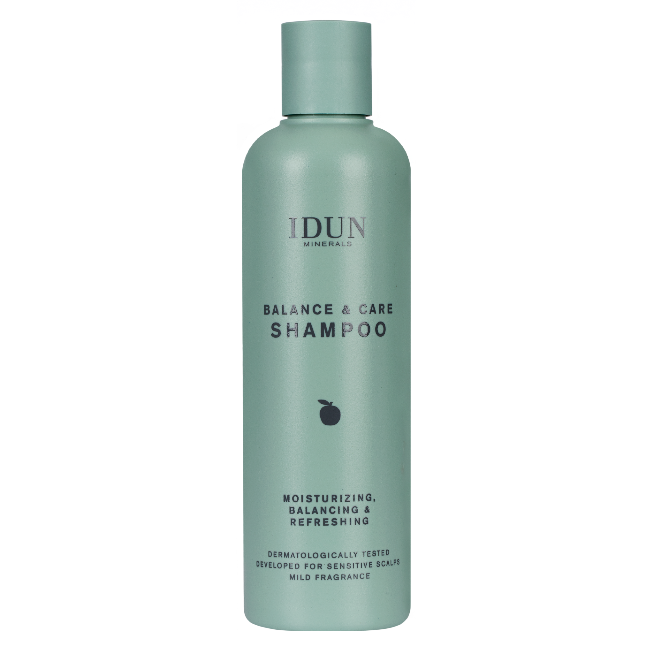
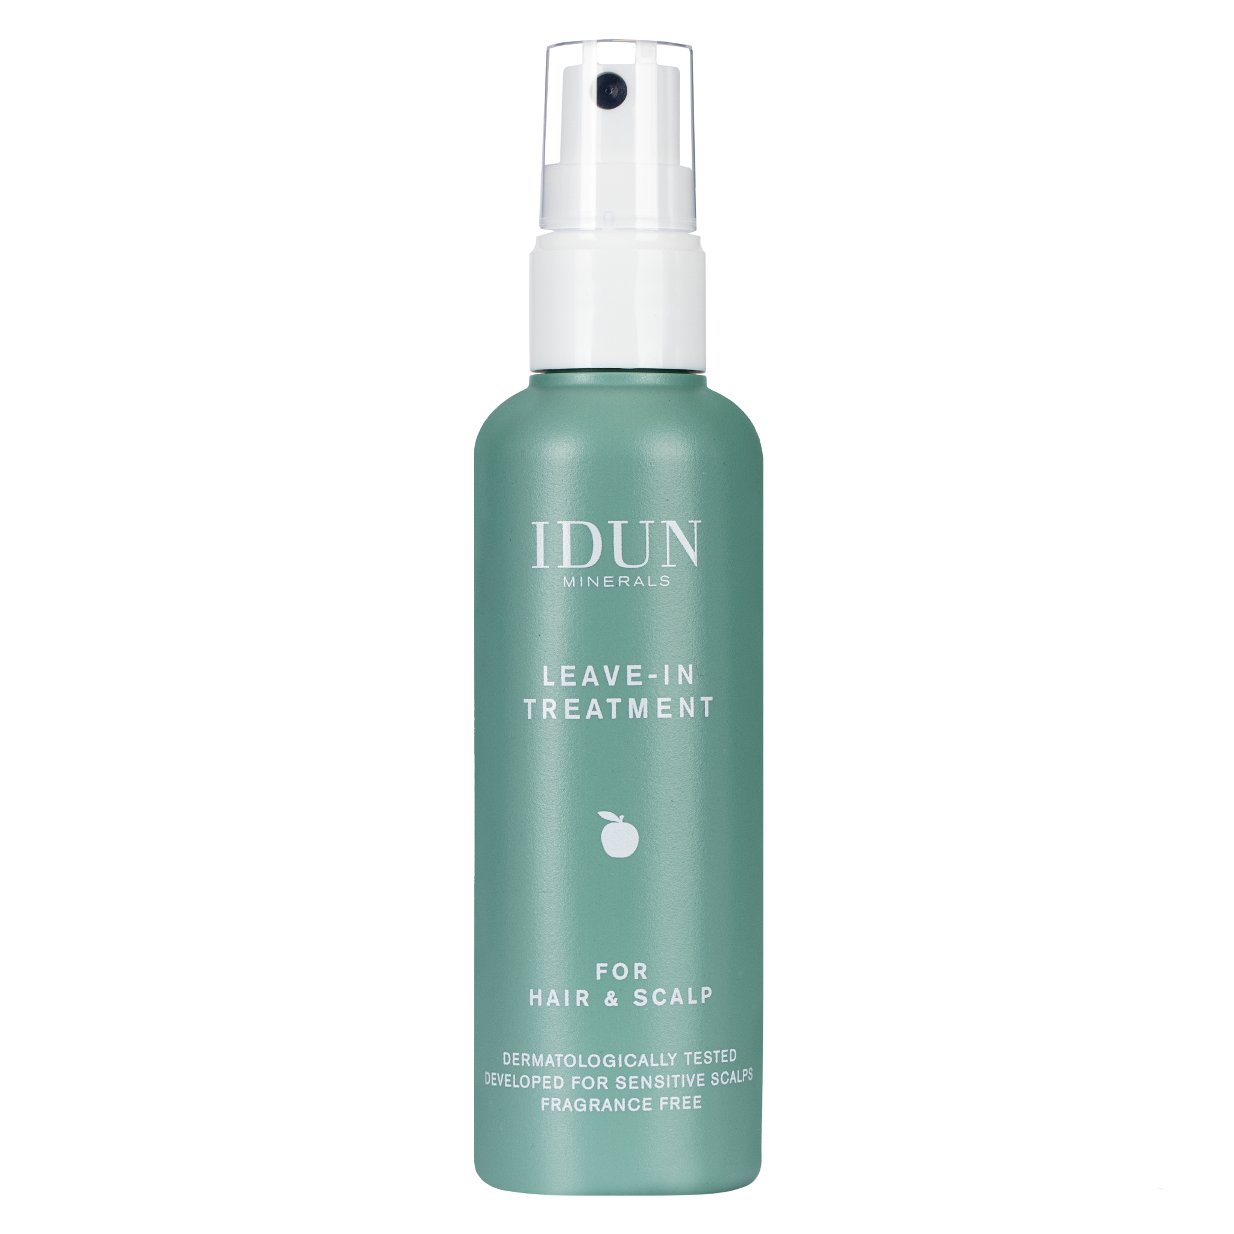
Set the Sustainability Strategy and Policy
Changed skincare and haircare packaging
IDUN Minerals was launched
Skincare
2018
2020…
2011
2017
2019
Asthma & Allergy Association
No to PFAS
Pharmacy exclusivity
Haircare
Makeup packaging transformation starts for almost 200 SKUs

Slide 10
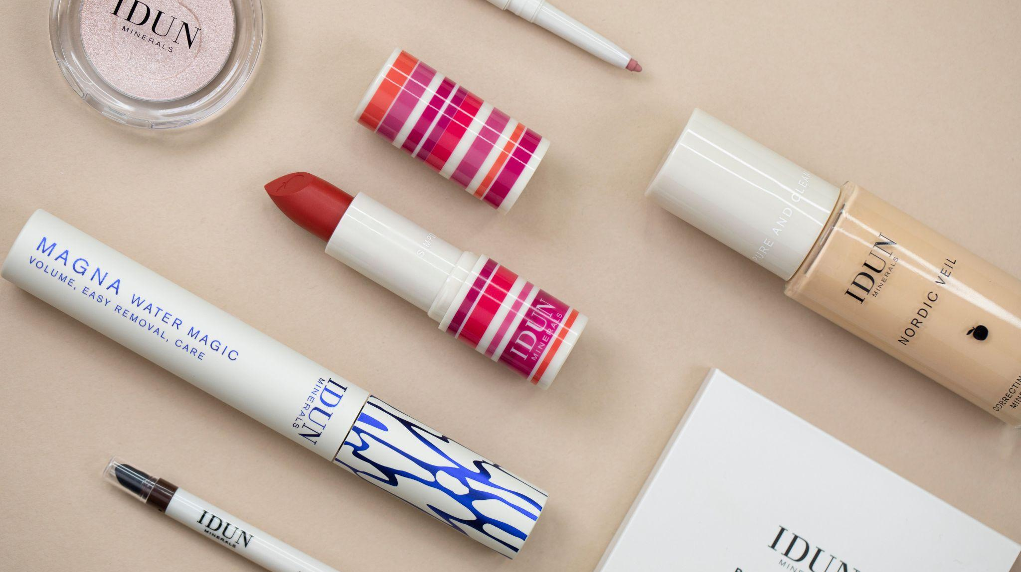

Slide 12
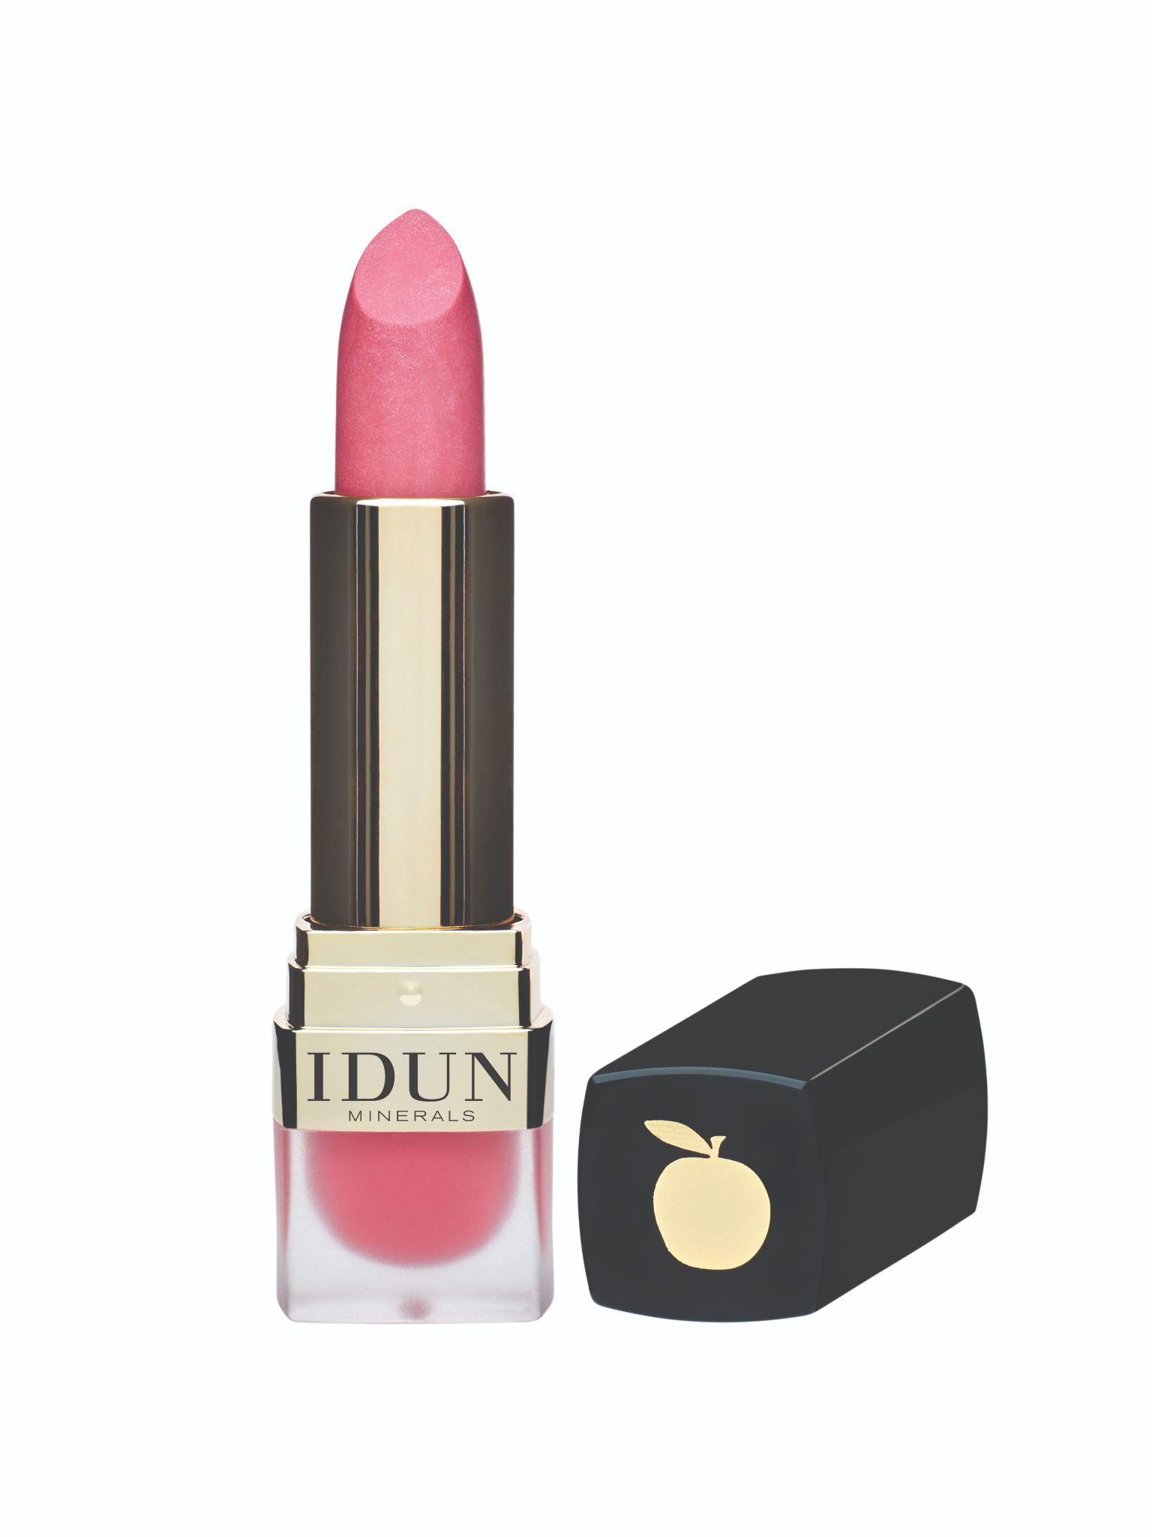
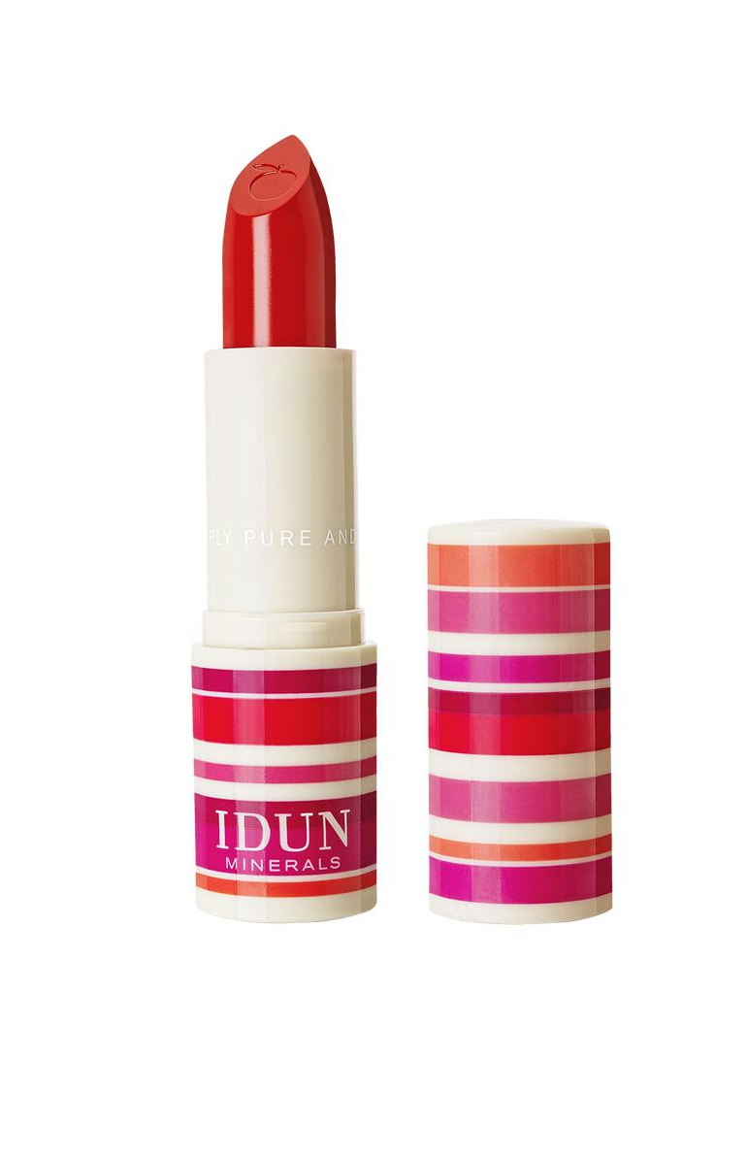
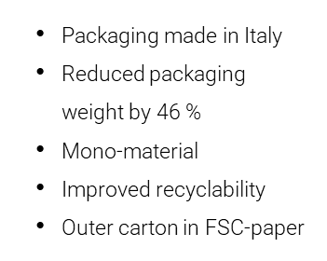
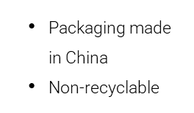
LIPSTICK MATTE & CREME

Slide 13
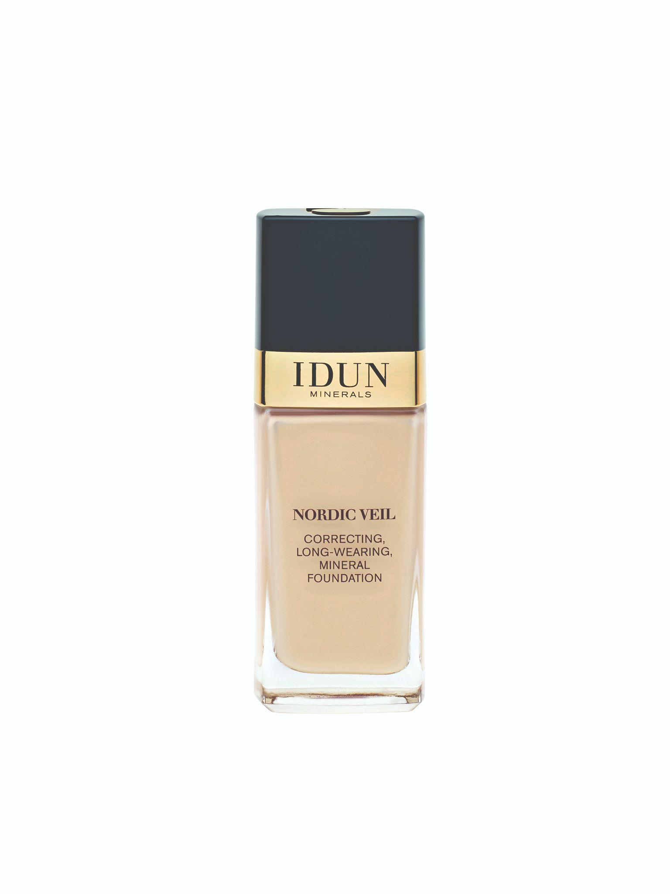
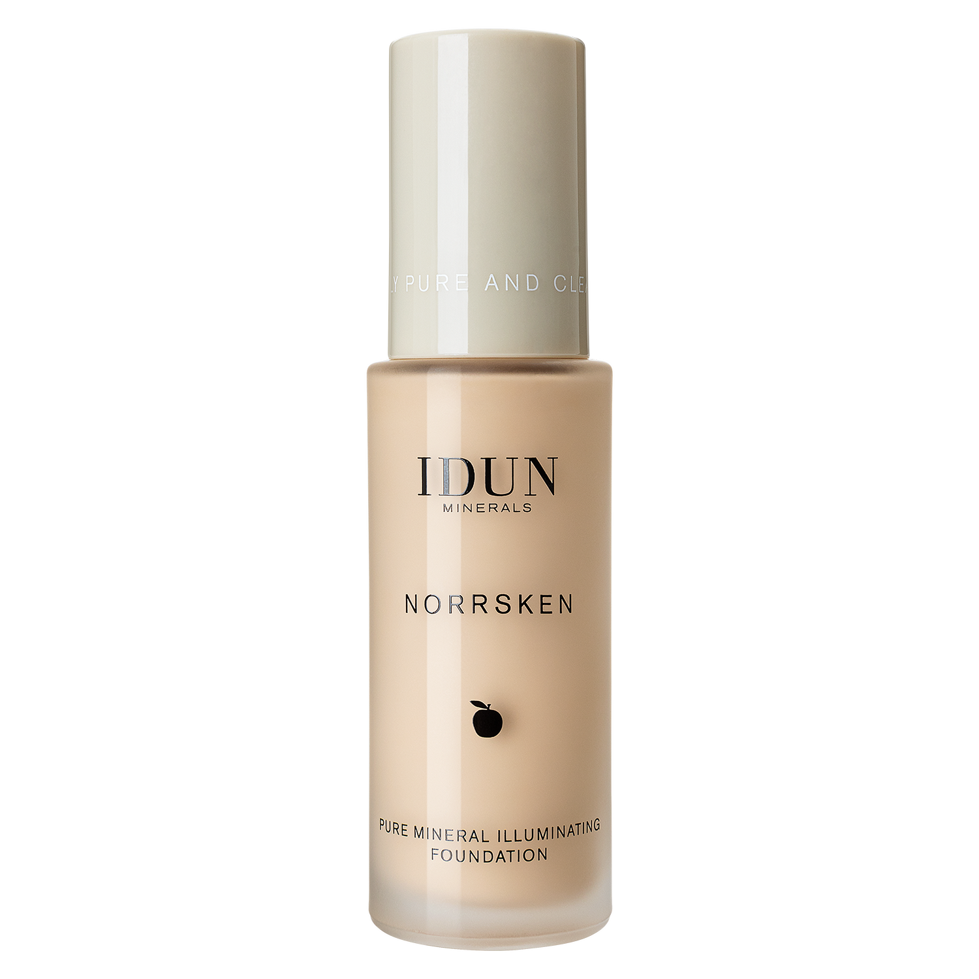
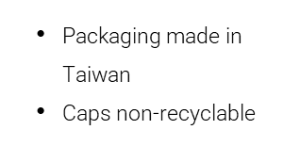
LIQUID FOUNDATION
Packaging made in Italy
Less material, reduced weight by 25 %, same volume
Improved recyclability
Outer carton in FSC-paper

Slide 14
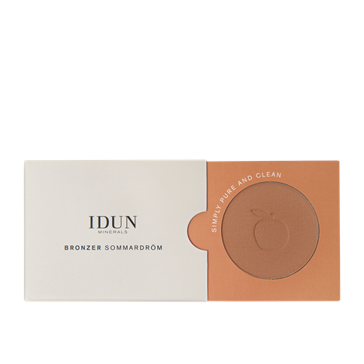
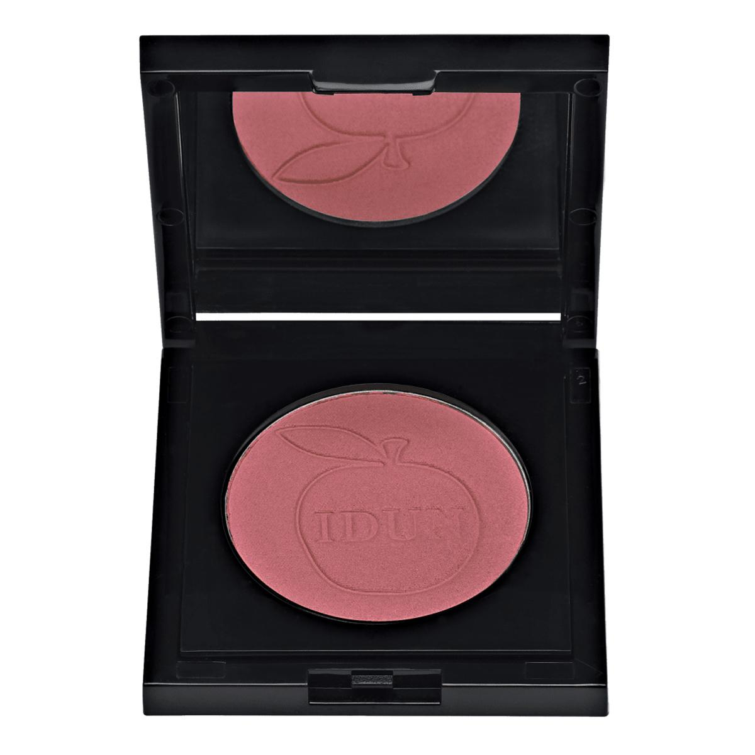
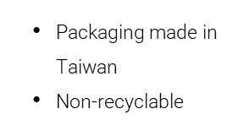
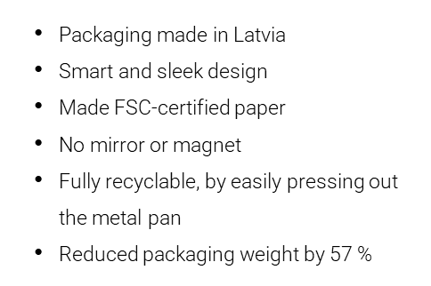
BRONZER & BLUSH

Slide 15
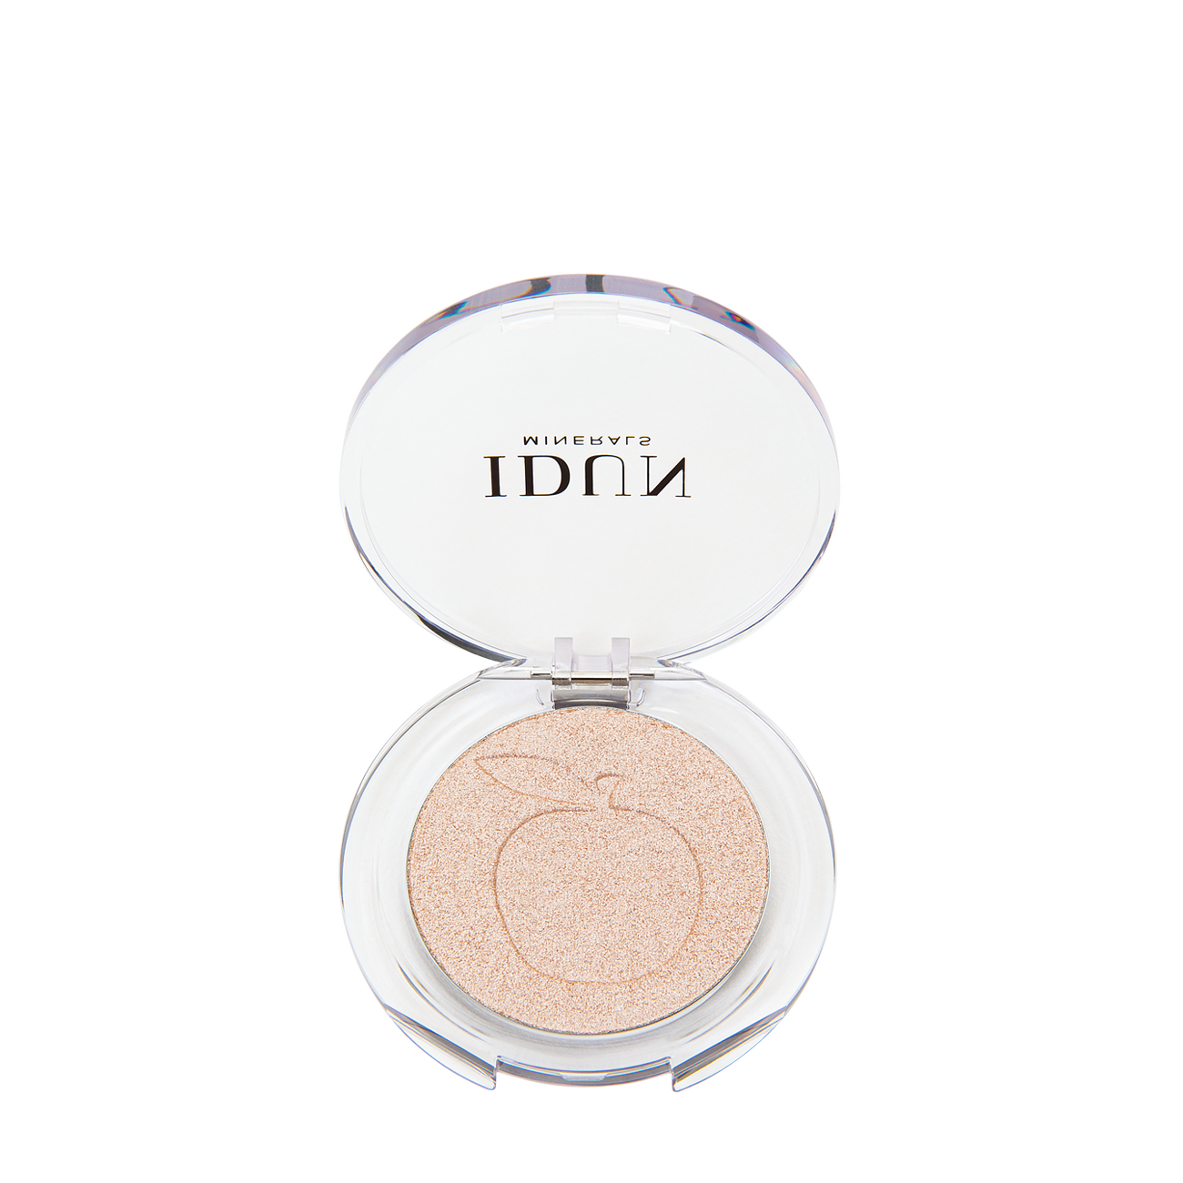
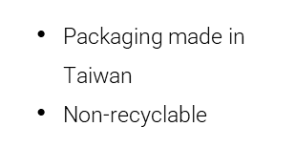
SINGLE EYESHADOW
Packaging made in Italy
Reduced packaging weight by 48 %
Improved recyclability
No mirror
Hole underneath

Slide 16
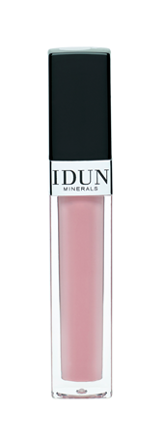
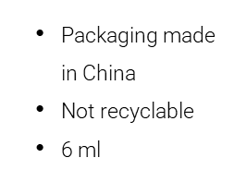
LIP GLOSS
Packaging made in Germany
Reduced packaging weight by 88 %
Improved recyclability
Less packaging, more product – now 8 ml
Outer carton FSC-certified

Slide 17
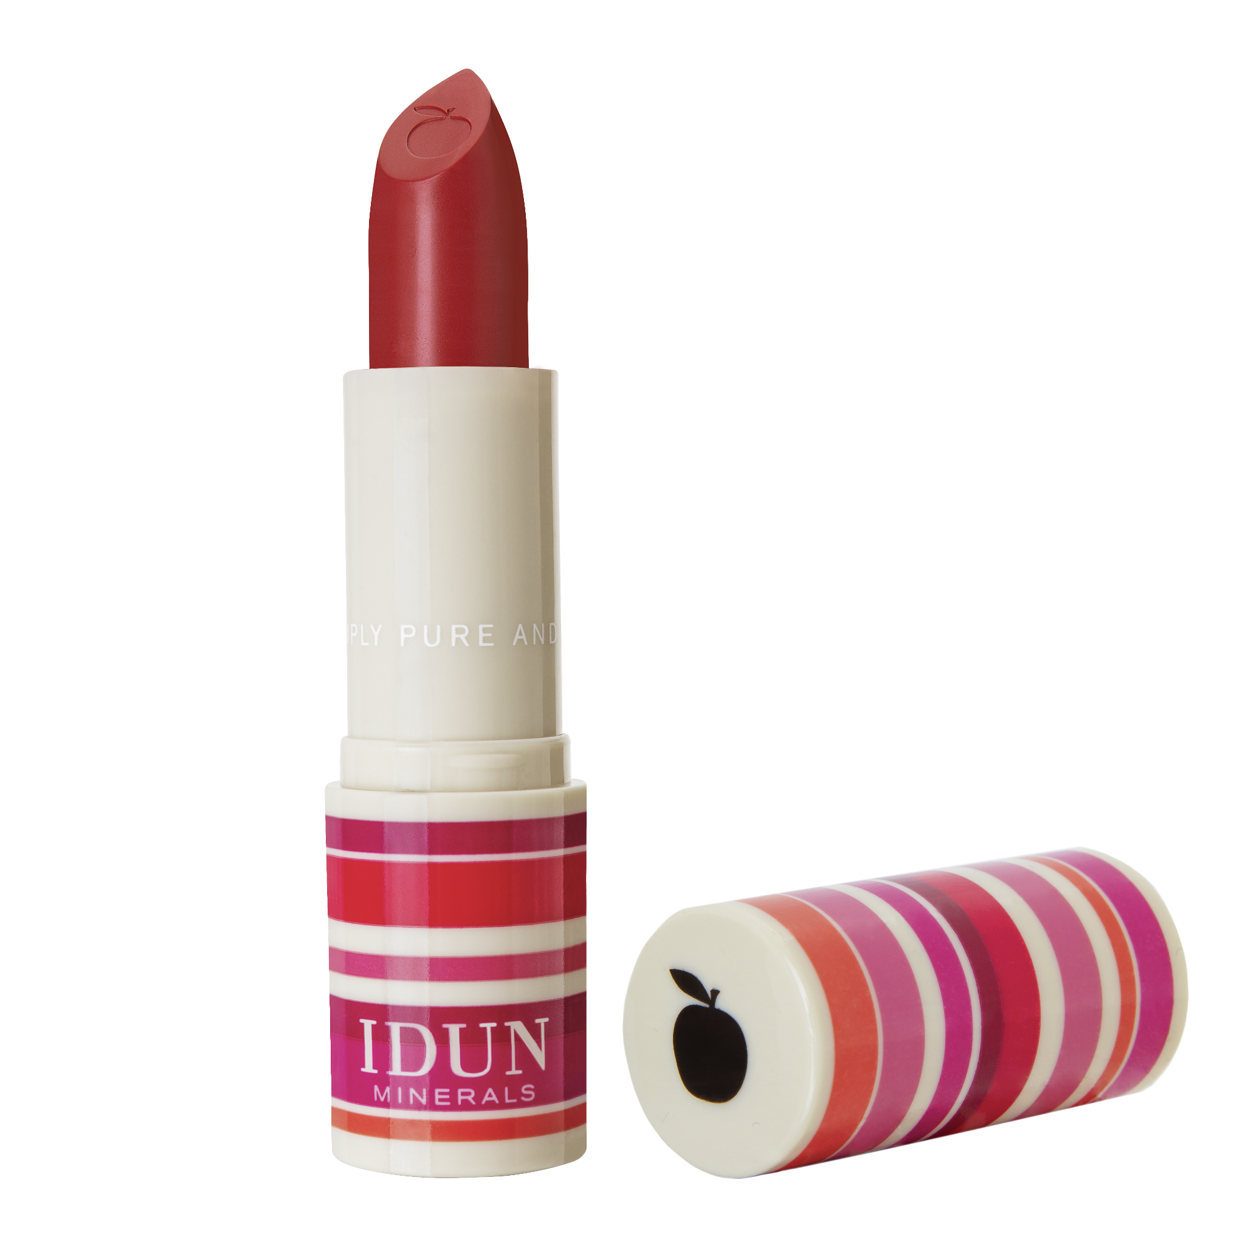
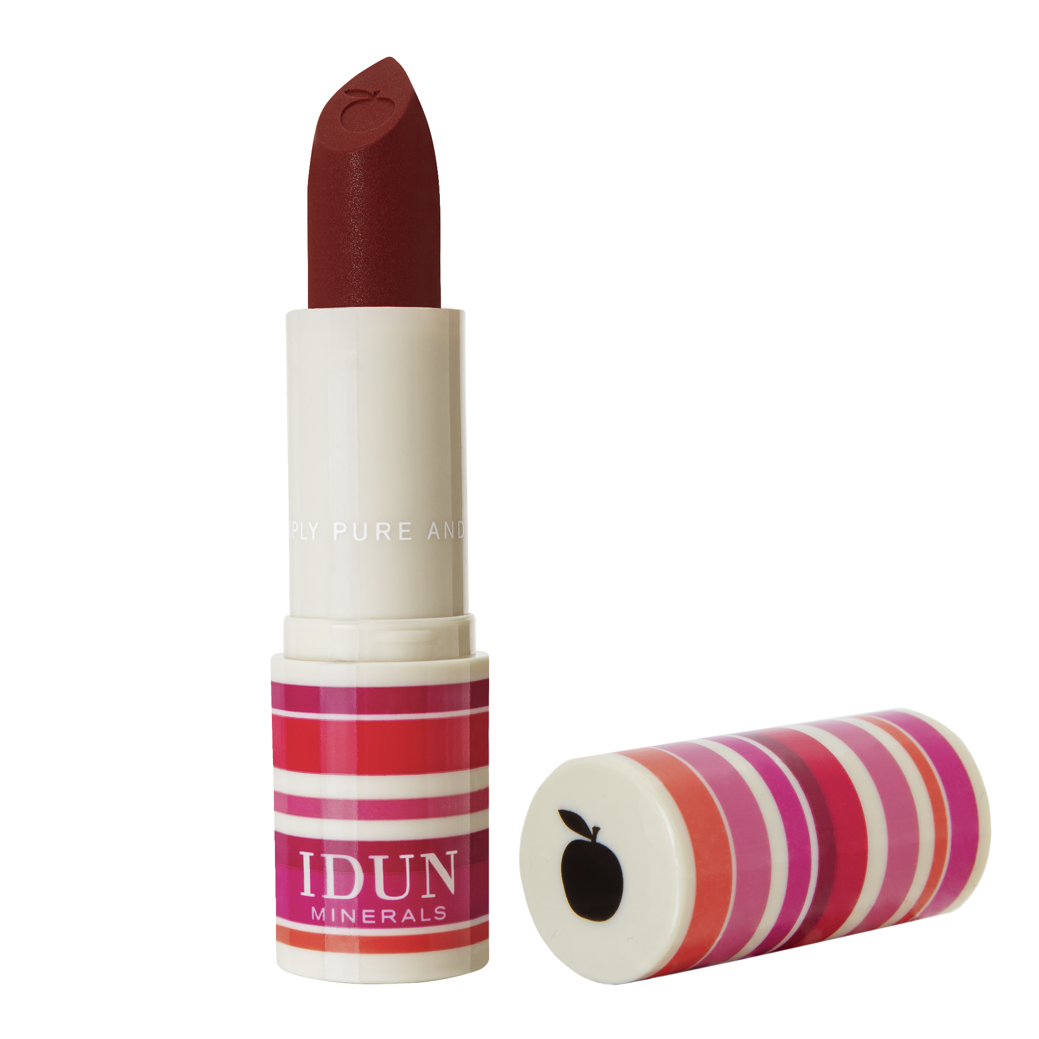
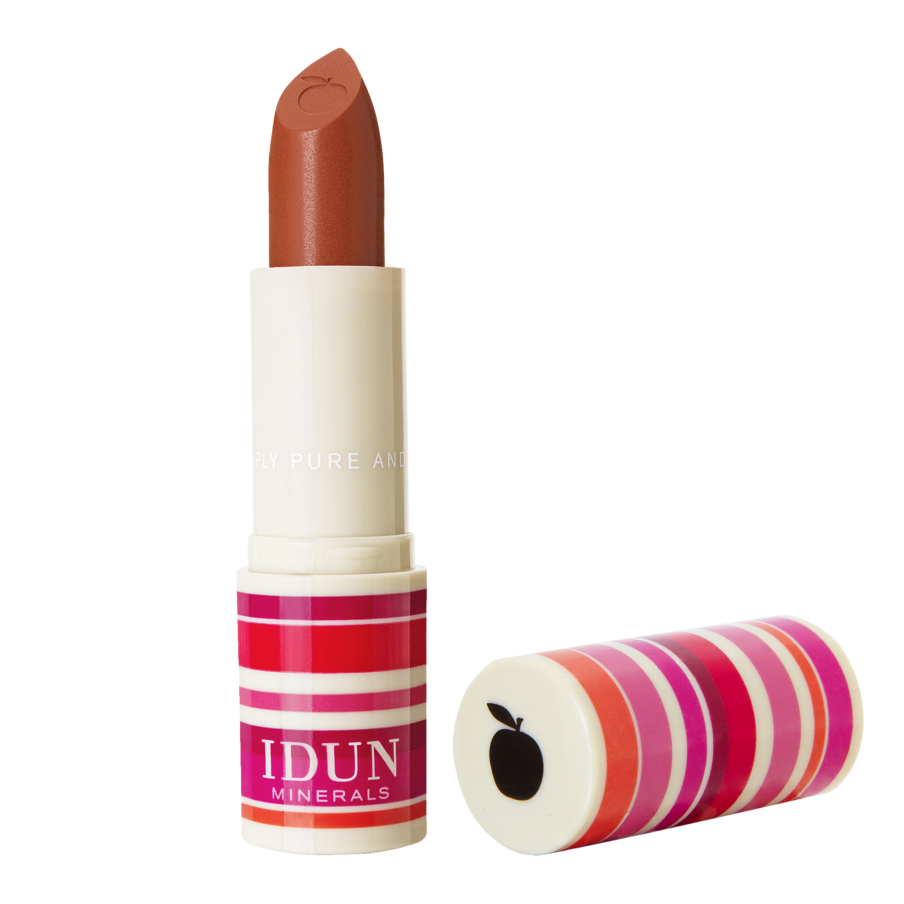
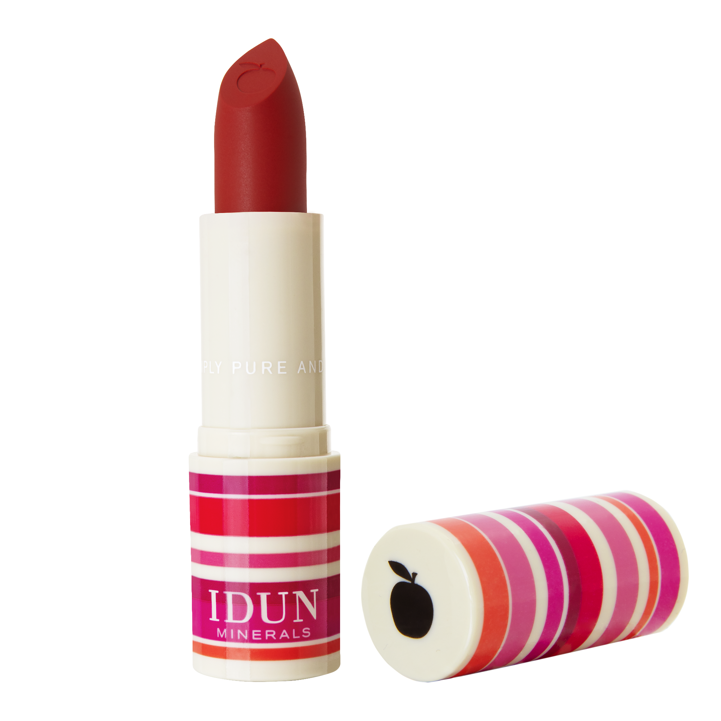
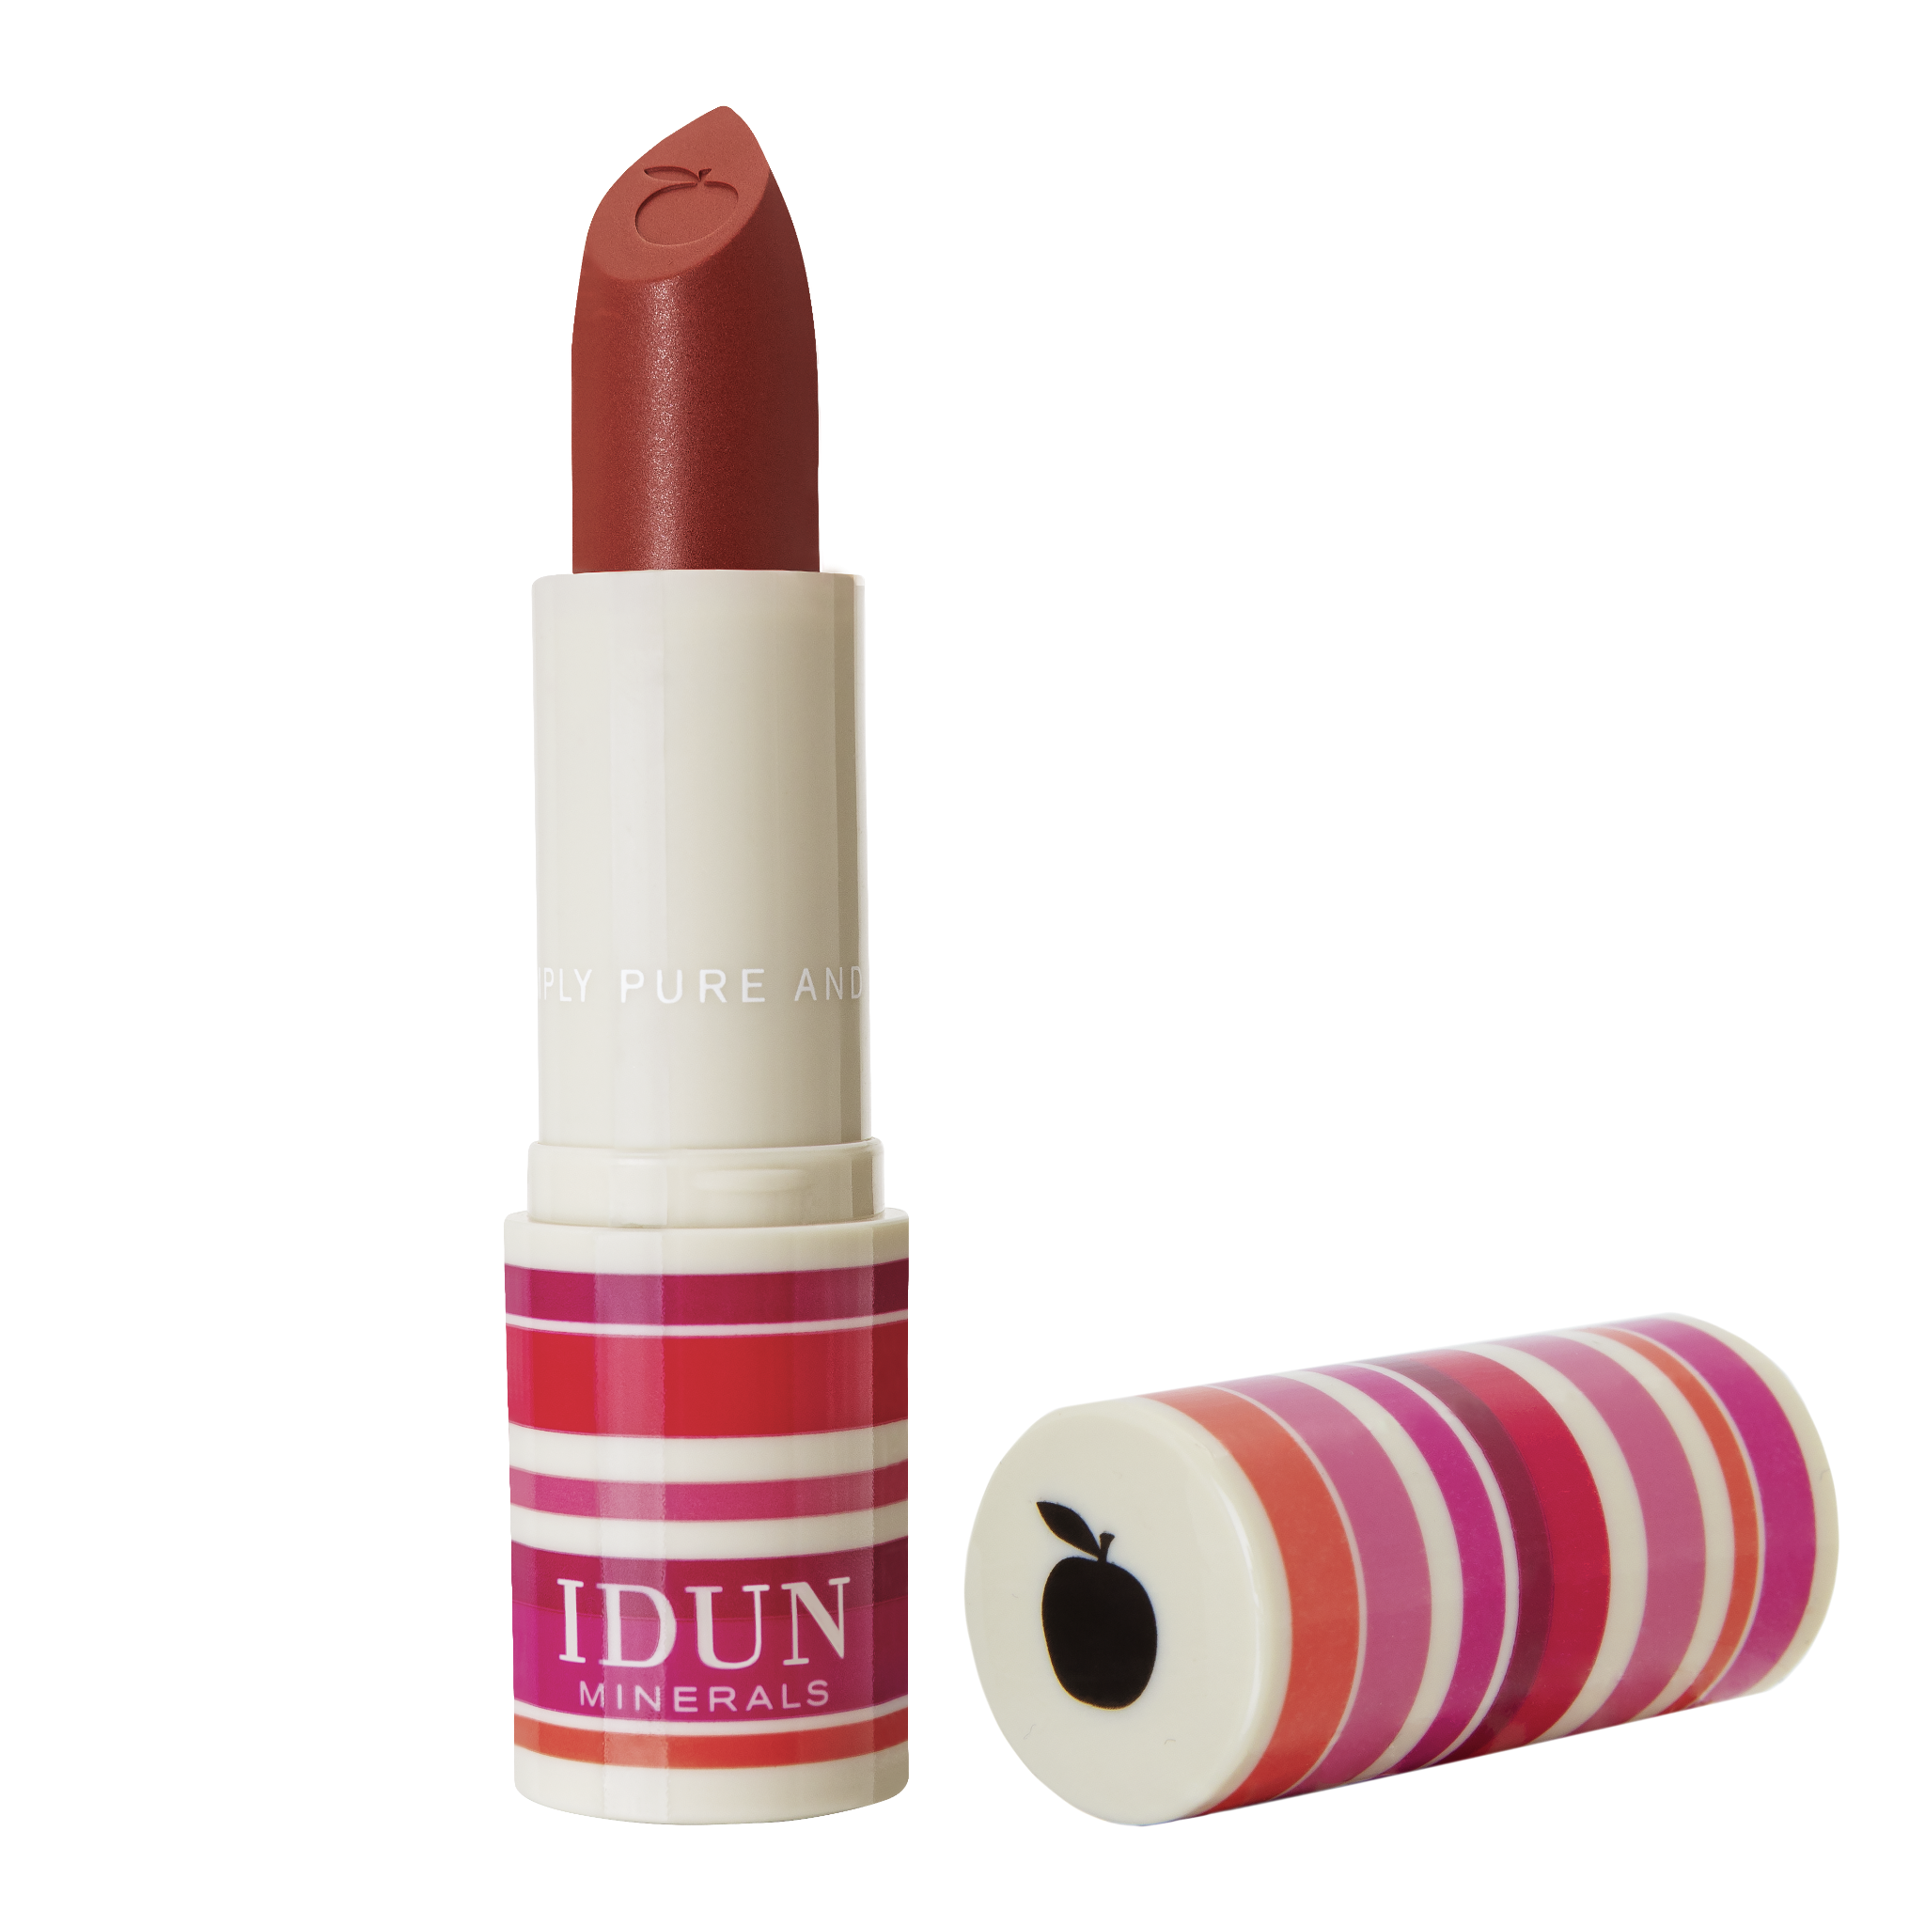
NEW DESIGN IS PHASED IN
Avoids wasting products that work perfectly fine
Communication is key…

Slide 18
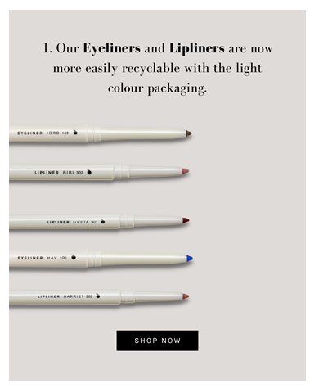
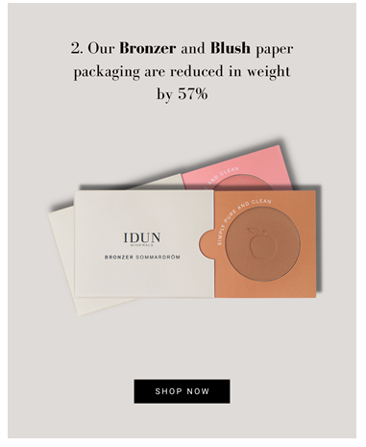
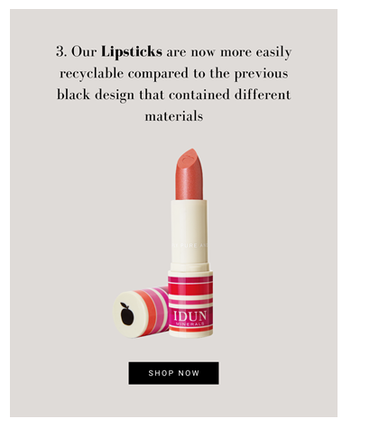
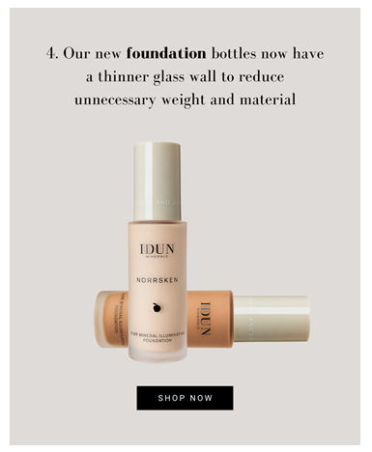
COMMUNICATION

Slide 19
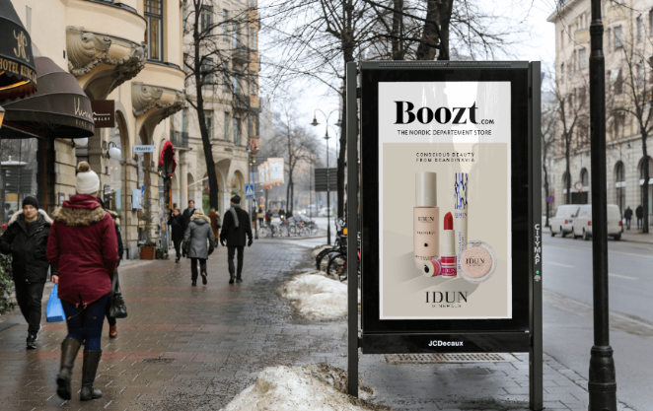

Slide 20
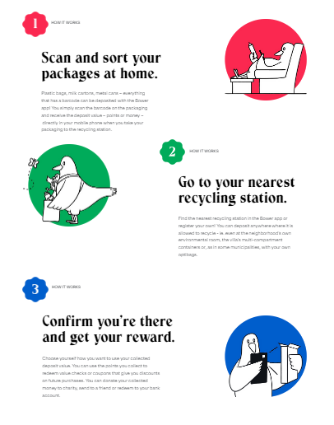
COMMUNICATION

Slide 21
THE IMPORTANCE OF COLLECTING INFORMATION
https://www.linkedin.com/feed/update/urn:li:activity:6902544935384662016

Slide 22
OUR WISH LIST
FOR A BETTER FUTURE
Simpler picture / logistics handling for agile solutions and no unnecessary hesitation
Communication across the entire value chain in the industry
Light and bright, the new luxury
Avoid “unnecessary” regulatory and legal demands “the way it always has been done”
Make sustainability the standard
Learn and inspire each other within the business

Slide 23
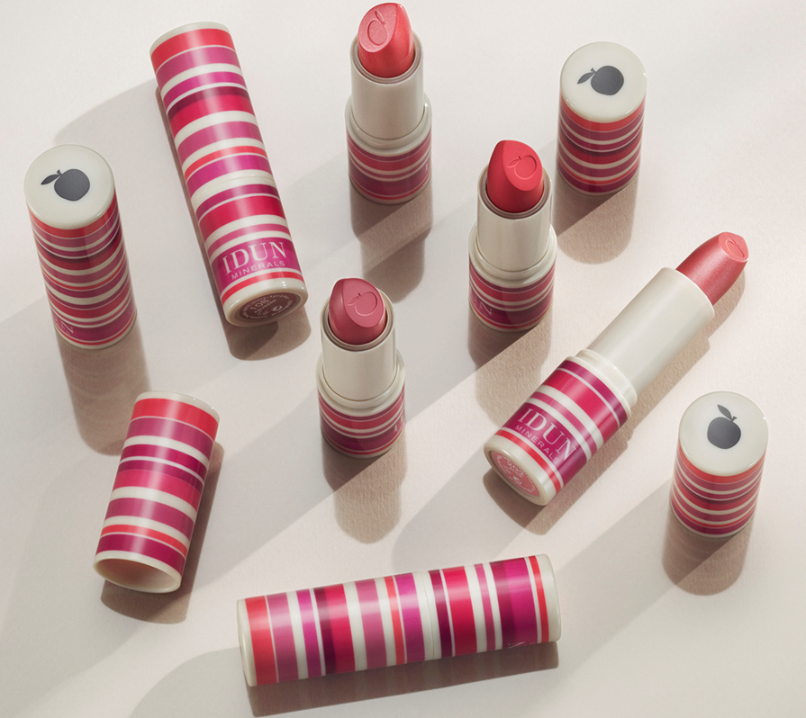
Z
YOUR CONSCIOUS
BEAUTY DESTINATION
FROM SWEDEN.

Slide 24
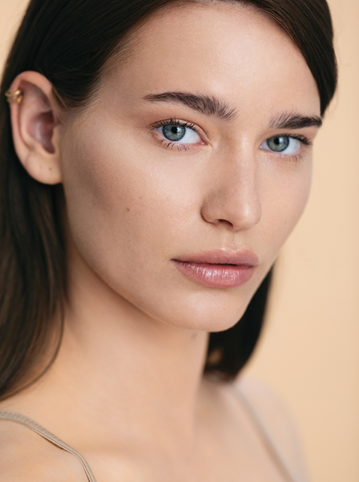
THANK YOU!

